Slide 1





Rethinking Big Data Scale:
Balancing Accuracy, Collaboration, & Storage
Panos K. Chrysanthis, Constantinos Costa
Department of Computer Science, University of Pittsburgh, USA
Rinnoco Ltd, Limassol, Cyprus
panos@cs.pitt.edu, costa.c@rinnoco.com,
November 14, 2025
IEEE CIC 2025

Slide 2
Outline
Motivation
Smart Data Sharing
  Accuracy
  Collaboration
  Storage
Intelligence within the Storage Layer
  Signature-based compression
  Postdiction-driven decay
Conclusions

Slide 3
Observation
The era of Big Data is not anticipated to reach its peak in the foreseeable future.
  Volume: size from a few tens of terabytes to many petabytes.
  Variety: multiple data models from structured (relational, tabular), semi-structured (JSON) or unstructured data (Web & log files).
  Velocity: generation/update rate from second to minute granularity.
  Veracity: accuracy and trustworthiness of the data.
  Value: the usefulness of the data.
Emerging technologies are pivotal in shaping the evolution of Big Data
  Internet of Things (IoT): The proliferation of IoT devices will exponentially increase the volume of data generated.
  AI & Machine Learning (ML): ML tools and AI agents will increase the volume of data generated, utilized, and exchanged.

Slide 4



Data storage Challenge
Forecast [IDC’24]: Data will grow at a compound annual growth rate of 19.2% to reach more than 394 zettabytes by 2028
“If one were able to store 394 ZB onto BluRay discs,
then you’d have a stack of discs that can get you to the moon 49 times…
or can circle the Earth approximately 472 times …”

Slide 5

Dark Data
12-15% operational & business critical
23 -25% redundant, obsolete, and trivial
60-65 % dark data hidden and forgotten but not necessarily useless

Slide 6








AI Agent Ecosystems
Application Layer
Smart
Environments
IoT
Smart Mobility
& Health
System Layer
Collaboration
Coordinator
Agent
Workload
Orchestrator
Resource
Optimization
Agent
Storage Layer
Databases
Data Lakes
Cloud

Slide 7
Challenge and Postulation
Big Data’s growth is far from its limit.
Collaborating AI agents will drive an exponential surge in data creation and exchange.
Expensive to store and transfer data (storage, indexing & bandwidth usage)
Big Data and AI Agent ecosystems strain resources for processing, communication and storage.
Smart Data Sharing: New data paradigm in which data layer is no longer static repositories, but adaptive, intelligent, and collaboration-aware systems.

Slide 8



Smart Data Sharing
Data is intelligently shared by balancing accuracy, collaboration, and storage.
Data layer is no longer static repositories, but adaptive, intelligent, and collaboration-aware systems—understand data value in context.
  Keep active data in place with lightweight compression for fast, interactive access.
  Migrate stable data to distributed tiers using signature-based lossless compression for major space savings.
  Apply decay and postdiction to balance accuracy, sharing, and long-term storage cost.
Smart Sharing Data Layer
Data Sharing Agent
Storage Layer
Postdiction Agent
AI Compression Agent

Slide 9



Smart Sharing Data Layer
Application Layer
Smart
Environments
IoT
Smart Mobility
& Health
System Layer
Collaboration
Coordinator
Agent
Workload
Orchestrator
Resource
Optimization
Agent
Smart Sharing Data Layer
Data Sharing Agent
Storage Layer
Postdiction Agent
AI Compression Agent

Slide 10
Key Design Dimensions
Accuracy, Fidelity and Usability
  Accuracy, fidelity & efficiency are inherently conflicting goals.
  Tunable accuracy in data reduction enables adaptation to users, tasks, and collaborations.
Data Classification & Workload Awareness
  Non-uniform data value: classify as fresh, hot, shared, archival, cold, or derived.
  Adaptive management: align storage form and access with workload and collaboration dynamics.
Data Volume and Network Awareness
  Network-aware systems: monitor transfers, minimize redundant replication.
  Prediction: forecast network overloads; trigger summarization/compression, caching, or delayed synchronization

Slide 11
Key Design Dimensions (cond.)
Collaboration Context and Policy Adaptation
  Evolving collaborations: collaboration patterns evolve as teams and projects over time.
  Adaptive systems: track: who, what, how often, and how fast to dynamically prioritize tasks and resource allocation while balancing performance and fairness.
Transparency, Fairness, and Trust
  Incorporate explainable models and auditing mechanisms to ensure that adaptive optimization aligns with human and organizational expectations.

Slide 12
Intelligence within the Storage Layer
At the core of smart data sharing lies continuous learning.
ML and AI models that classify workloads, predict usage spikes, detect redundant operations, and optimize compression and data placement policies.
Two examples of AI-driven mechanisms:
  Signature-based compression
  Postdiction-driven decay

Slide 13
Signature-Based Compression
Current systems adopt a single compression technique by broad file type.
Multi-scheme data compression selects different compression schemes for different columns based on their type and data characteristics (signature).
  Applicable for lossless and lossy compression schemes
  Enables incremental compression and partial decompression
Current schemes explore only lossless compression techniques.
  SIBACO [SMDB@ICDE ’23] : single criterion: entropy
  TigerData [TigerData.com ‘24]: single criterion: data type
  COMPASS [rinnoco.com, ‘24]: multiple criteria: data type, entropy, features (e.g., data distribution)
Notes:
Can we do better?

Slide 14

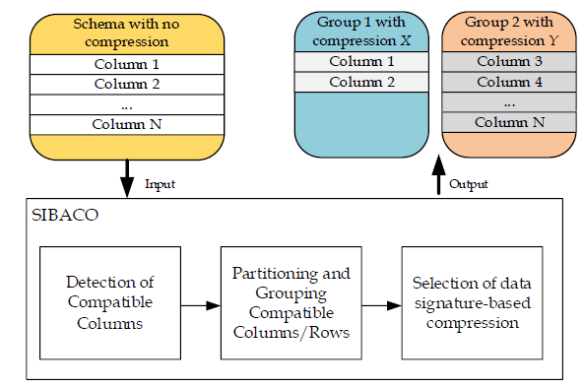
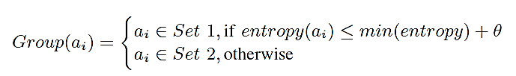
SIBACO Overview
Low-entropy attributes enable high compression ratios.
Partitioning and grouping of compatible columns/rows
  Group 1:consists of the columns less than the threshold
  min(entropy) + θ,
  where θ is set based on empirical data (e.g., θ = 0.3).
  Group 2: the remaining columns with entropy greater than threshold
Selection of data type-based compression
  Selects the most appropriate compression algorithm.
    exhaustive search (test everything)

Slide 15


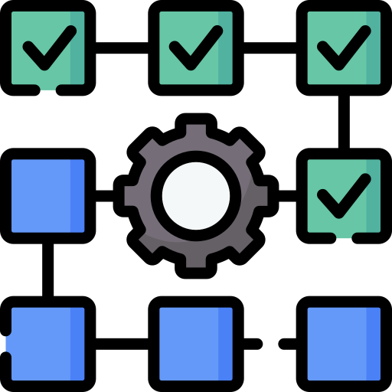
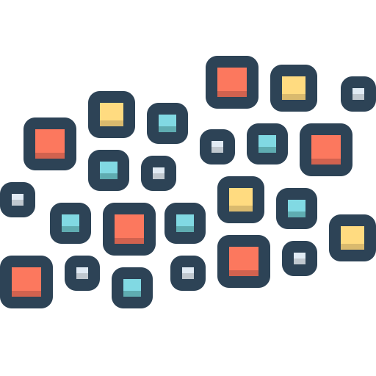

COMPASS Learning Phase
1
2
3
4
[ Read Data ] [ Cluster by Signature ] [ Evaluate Compressors ] [ Store Best Settings ]
Training input data (1)
Scalable Clustering (2): Groups columns by actual data signatures (K-Means on data values, entropy, features).
Exhaustive Testing (3): Runs every compressor/cluster combo to find the true sweet spot.
Future-Proof Profiles (4): Persists chunk-level metadata for instant re-tuning as data evolves.

Slide 16
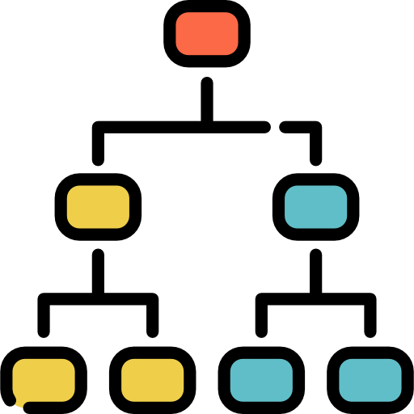
COMPASS Compression Phase
From raw data to optimized storage—in four automated steps
1
2
3
4
| Read Data | |Profile & Cluster | |ML–Select Algo | | Store Compressed|
Automated at Scale: End-to-end pipeline can run on petabyte-scale tables with no manual tuning.
Data-Aware Intelligence: Profiles each chunk’s actual properties (points, entropy, features) before clustering.
Optimal Outcomes: ML-driven compressor choice yields up to 46 % more reduction vs. legacy and 7 % vs. state-of-the-art.
Dropbox 17.8 M users, $9.99/2TB/month, $0.70/month savings→$12.4M/month

Slide 17
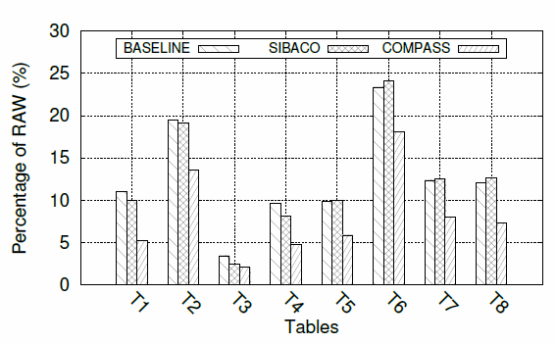
COMPASS Evaluation
Schemes
  COMPASS (DEFLATED, BZIP2, LZMA: & K-Means clustering)
  SIBACO (DEFLATE, BZIP2, LZMA & two cluster scheme)
  BASELINE (monolithic – BZIP2)
DataSets
  Εight largest tables in the EnvMon DB (1GB)
COMPASS achieves the highest compression.
  Reduction down to 2% - 18.2 % of the original size
  Outperforms BASELINE and SIBACO by at least 22% and up to 56% (~2x).

Slide 18
Data Decay
Data lose its usefulness over time.
  This could be at different granularities (e.g., an entire table or specific columns in a table)
Data decay policy dynamically reduces data size, accuracy, or deletes it.
  Data aggregation
  Data reduction (SVD, DFT, DWT)
  Data sampling (uniform, stratified or random)
  Data synopsis (e.g., equiwidth/depth histograms, Bloom filters, sketches)
  Data compression (lossless or lossy)
  Data Postdiction

Slide 19
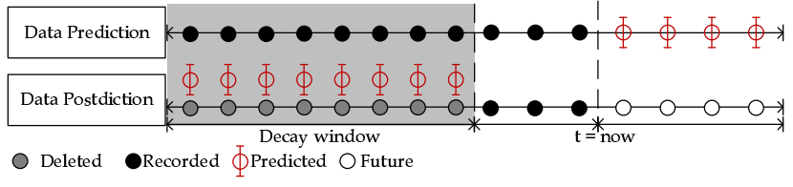
Data Postdiction
Data Postdiction (DP): aims to recover the past value of some tuple, which has been decayed for efficiency purposes, using a ML model.
  Data Prediction: aims to make a statement about the future value of some tuple using a ML model.
GeoInformatica '19
& MDM ‘18

Slide 20
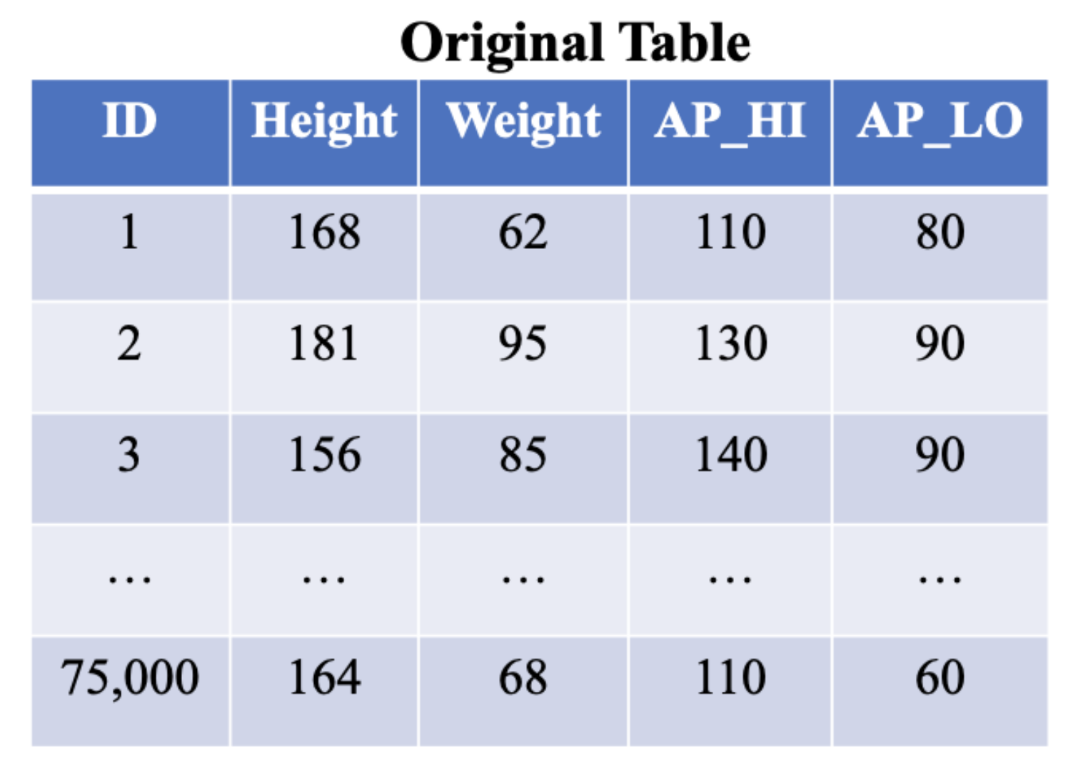
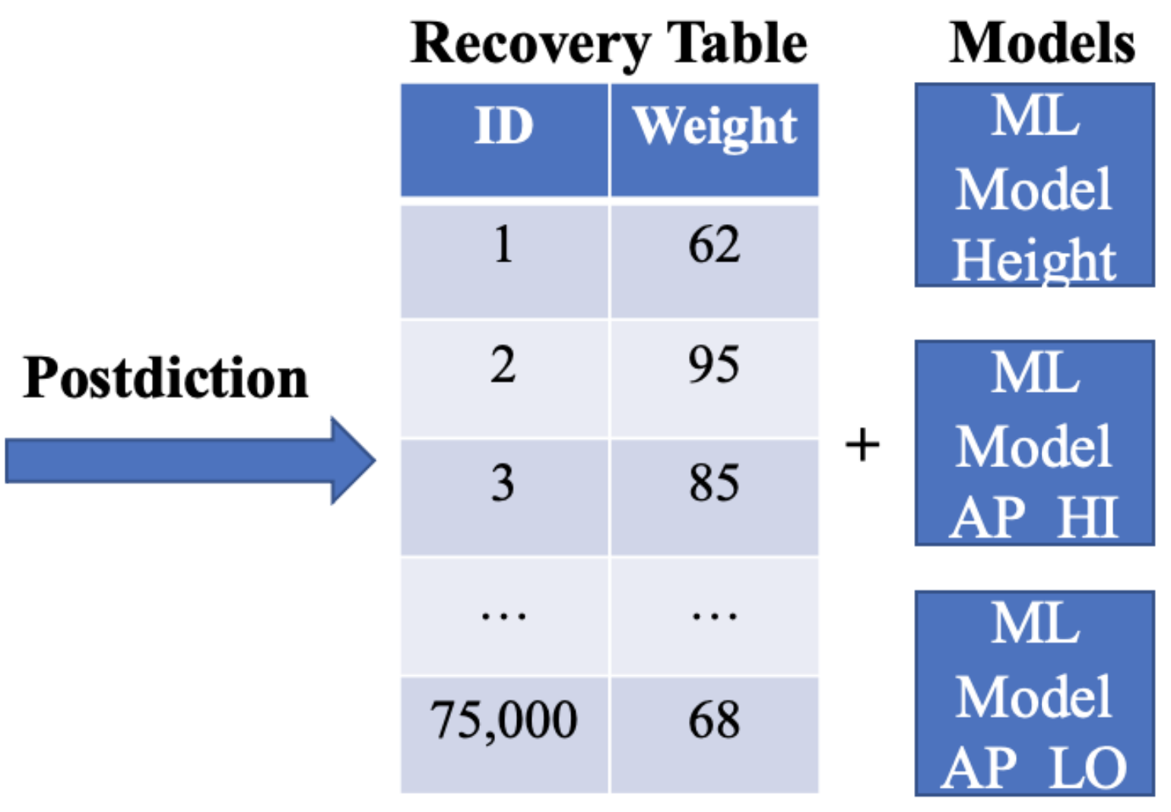
Data Postdiction Example
Ulianova, S.: Cardiovascular disease dataset (2019)
ADBIS ‘23

Slide 21
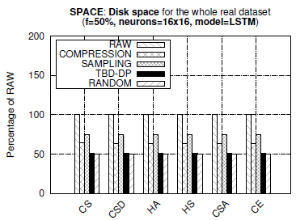
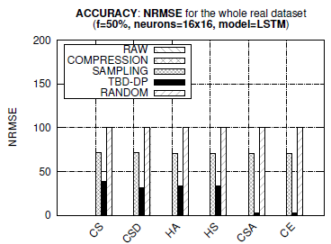
Space and Accuracy
  TBD-DP provides 25%, 50% better space capacity than COMPRESSION and RAW, respectively.
  TBD-DP outperforms the SAMPLING approach by 50% in terms of NRMSE, on average, in all datasets.
  COMPRESSION approach provides an optimal NRMSE = 0 (GZIP is lossless, but requires more space)
  TBD-DP could have been configured with a decay factor f=100% rather than f=50%, yielding even less space (i.e., decay everything, retain only model approach)

Slide 22
Postdiction Pipeline
Input
Data Decay
Output
Outlier Table
Recovery Table
ML Models
Storage Size
Recovered Accuracy
Data
Error Tolerance / Accuracy
Clustering
ML
Accuracy Tuning
Outlier Detection
First implementation:
Outlier Detection: Z-score, Isolation Forest
Clustering: K-means, Density-based spatial clustering (DBSCAN), Gaussian Mixture Modelling (GMM)
Machine Learning: LSTM
ADBIS ‘23

Slide 23
Outlier Detection
ID | Height | Weight
1 | 168 | 62
Outlier Table
2 | 181 | 59
ID | Height | Weight
3 | 156 | 85
4 | 133 | 60
5 | 178 | 90
6 | 175 | 91
7 | 166 | 68
8 | 159 | 72
9 | 166 | 62
10 | 170 | 83
11 | 171 | 95
12 | 140 | 65

Slide 24
Clustering
ID | Height | Weight
ID | Height | Weight
3 | 156 | 85
1 | 168 | 62
3 | 156 | 85
5 | 178 | 90
Outlier Table
6 | 175 | 91
4 | 133 | 60
ID | Height | Weight
7 | 166 | 68
5 | 178 | 90
2 | 181 | 59
8 | 159 | 72
6 | 175 | 91
11 | 171 | 95
13 | 164 | 68
7 | 166 | 68
8 | 159 | 72
ID | Height | Weight
Pipeline | Num. Models | Num. Outliers | Recovered Accuracy
No Clustering / Outlier Detection | 1 | 0 | 18.7425
Clustering Only | 2 | 0 | 30.97082
Outlier Detection Before Clustering | 2 | 14301 | 47.43767
9 | 166 | 62
1 | 168 | 62
10 | 170 | 83
4 | 133 | 60
12 | 140 | 65
9 | 166 | 62
13 | 164 | 68
10 | 170 | 83
Outlier detection: Z-score
Clustering: K-means
  *Recovered accuracy = percent of samples within designated error threshold (5%)
12 | 140 | 65

Slide 25
Accuracy Tuning
ID | Height | Weight | Pred. Error
3 | 156 | 85 | 4%
Outlier Table
5 | 178 | 90 | 4%
ID | Height | Weight
6 | 175 | 91 | 1%
2 | 181 | 59
7 | 166 | 68 | 3%
11 | 171 | 95
8 | 159 | 72 | 1%
13 | 164 | 68 | 2%
ID | Height | Weight | Pred. Error
Pipeline | Num. Models | Num. Outliers | Recovered Accuracy
No Clustering / Outlier Detection | 1 | 0 | 18.7425
Clustering + Accuracy Tuning | 2 | 18036 | 100.00
Outlier Detection Before & After Clustering + Accuracy Tuning | 2 | 28064 | 100.00
1 | 168 | 62 | 4%
4 | 133 | 60
4 | 133 | 60 | 10%
9 | 166 | 62 | 4%
10 | 170 | 83 | 2%

Slide 26

Final Output
Recovery Tables
ID | Height
ID | Height
3 | 156
Machine Learning Models
1 | 168
3 | 156
Outlier Table
5 | 178
ID | Height | Weight
6 | 175
4 | 133
7 | 166
2 | 181 | 59
5 | 178
8 | 159
11 | 171 | 95
6 | 175
4 | 133 | 60
13 | 164
12 | 140 | 65
7 | 166
12 | 140 | 65
ID | Height
9 | 166
Output Statistics
1 | 168
10 | 170
Recovered Accuracy: 100%
Percent Outliers: 30.77%
9 | 166
10 | 170

Slide 27
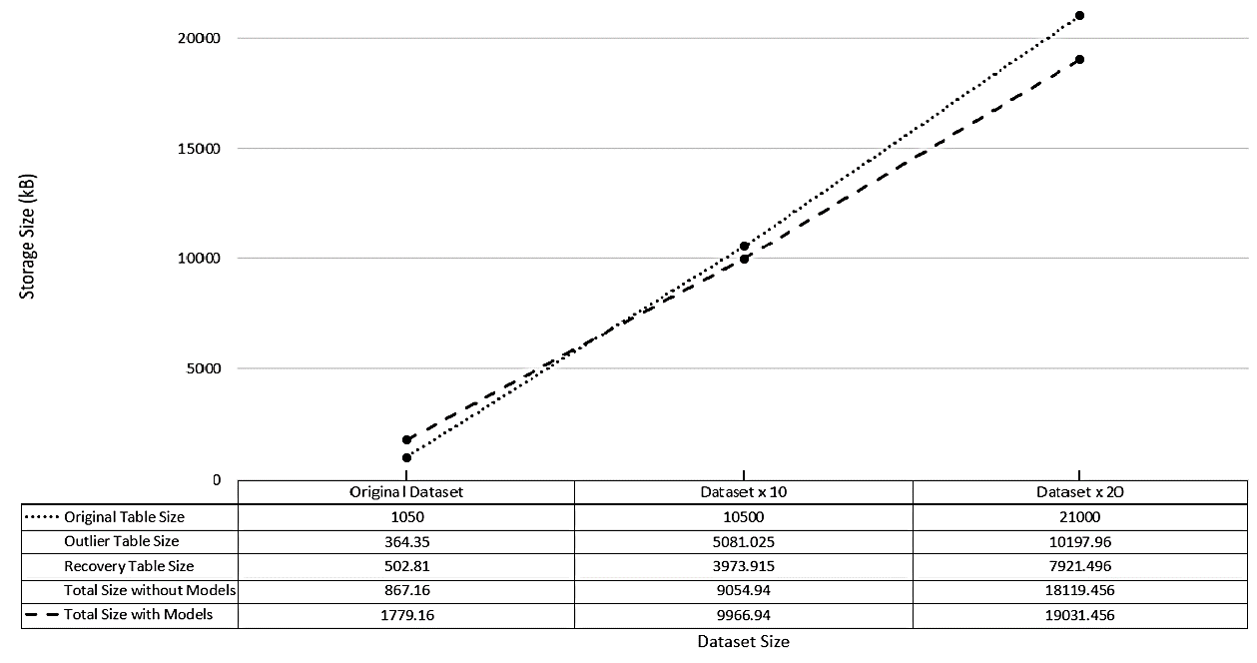
Applicability of Postdiction & Scaling
Inflection Point

Slide 28
Machine Learning Impact
Input
Data Decay
Output
Outlier Table
Recovery Table
ML Models
Storage Size
Recovered Accuracy
Data
Error Tolerance / Accuracy
Clustering
ML
Accuracy Tuning
Outlier Detection
Machine Learning Models:
  First implementation: LSTM
  Current implementation: Linear & Polynomial Regression
Observations:
  Raw data reduction was comparable in two implementations
  Overall gains varied with data and number of models.

Slide 29
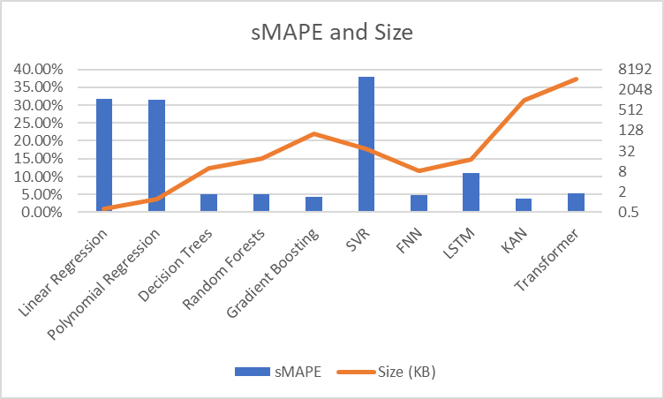
Machine Learning Selection
Linear & Polynomial Regression
    Fast, but high error (sMAPE ~31%).
Tree-based Models
    Low sMAPE (≤5.2%), efficient size.
Deep Learning Models
    Good accuracy (KAN best at 3.9% sMAPE), but larger size and longer training time.
Transformer
    Strong performance (5.23% sMAPE) but heavy (4263 KB, 2412s training).
Dataset: Power consumption residential houses
Rows: 1,000,000
Features: 12
Predicted column size: ~6 MB
Metrics:
NRMSE: normalized root mean square error
sMAPE: symmetric mean absolute percentage error
Model size & Compression ratio
Training time
No single ML fits all data

Slide 30
Smart Sharing Data Layer
Application Layer
Smart
Environments
IoT
Smart Mobility
& Health
System Layer
Collaboration
Coordinator
Agent
Workload
Orchestrator
Resource
Optimization
Agent
Smart Sharing Data Layer
Data Sharing Agent
Storage Layer
Postdiction Agent
AI Compression Agent

Slide 31
Data Volume and Network Awareness
Signature-based compression preserves fidelity while postdiction manages data decay.
Together, they establish a foundation for adaptive systems that can continuously balance accuracy and efficiency.
Within smart-sharing, collaborators adapt data exchange using raw, compressed, or compact data according to workload, resource constraints, and collaborative context.
Study of how network limits shape data exchange in sensor collaborations.
  Each collaborator stores a set of pretrained polynomial regression models.
  Sensor readings (32 bits) are replaced with compact models (4-7bits).

Slide 32
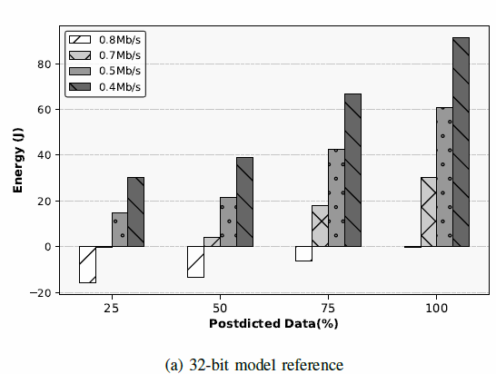
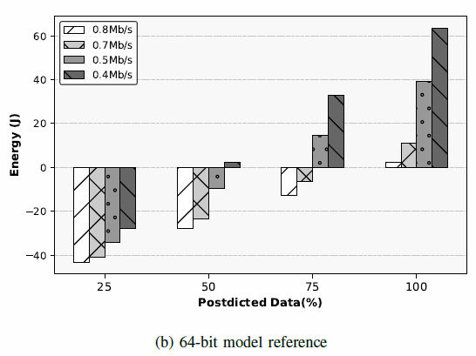
Experimental Results
Measure compute (regression) and transmission energy on Raspberry Pi 5
Postdiction saves if T_{transmit} > (Power_{compute}/Power_{transmit}) T_{compute}
Postdiction saves energy when bandwidth is below ~0.8 Mb/s (32 models) and ~0.4 Mb/s (64 models) at 50% accuracy.
Energy savings are substantial at 100% accuracy across all bandwidths.
32 Pretrained Models
64 Pretrained Models

Slide 33
Conclusions
The vision outlined in this paper redefines the foundation of data scalability.
  Rethinking big data scalability through adaptive, collaboration-aware storage.
  Moving beyond static, capacity-driven designs to learning, adaptive systems.
  Embedding intelligence in the storage layer for real-time reasoning.
  Balancing accuracy, cost, and workload dynamics to enable efficient collaboration.
  Using two complementary mechanisms—signature-based lossless compression and postdiction-driven decay—demonstrate the feasibility of holistically optimizing data sharing and storage.
Achieving this vision will require integrating advances from data management, artificial intelligence, and network systems.

Slide 34
Acknowledgement
The authors would like to thank
  the students of the ADMT Lab of the University of Pittsburgh, specifically, Brian T. Nixon, Kartik Hans and Vasilis E. Sarris, and
  the interns at Rinnoco Ltd, namely, Spyros Sachmpazidis and Stelios Mavris, both students at the University of Cyprus.
  All have contributed to the discussions, experiments, and prototypes that supported this work.

Slide 35
Rethinking Big Data Scale:
Balancing Accuracy, Collaboration, & Storage
Panos K. Chrysanthis, Constantinos Costa
Department of Computer Science, University of Pittsburgh, USA
Rinnoco Ltd, Limassol, Cyprus
panos@cs.pitt.edu, costa.c@rinnoco.com,
Thanks! Questions?

