Slide 1



Advancing Big Data Storage with Machine Learning at Rinnoco Ltd
Constantinos Costa
costa.c@rinnoco.com
Co-founder & CEO,
Rinnoco Ltd
https://costadb.com
September 17, 2025
FSK 2025

Slide 2

Who we are
Rinnoco Ltd is a research, innovation, and education consulting company, which was founded at the end of 2021 and is based in Limassol, Cyprus.
The founders of the company have over 30 years of diverse research experience, including SQL and NoSQL databases, big data and data streams, spatiotemporal systems, mobile computing, sensor networks and internet of things (IoT), machine learning applications, and quantum mechanics.
More on our website (https://rinnoco.com/).

Slide 3

What we do
We leverage our research and our academic background to build ML‑driven storage platforms that slash storage capacity needs by ≥ 45%.
We are developing two software storage tools as the first part of our long-term plan. The two tools are:
A Signature Based Compression tool (PLATCOM).
A Data Decay tool (PLATDEC).

Slide 4
Outline
Introduction & Motivation
Big data architectures, apps & tools
PLATCOM
PLATDEC
Conclusions
Future work

Slide 5
Big Data Applications
New applications operate on big data!
Social
Spatiotemporal
Spatial

Slide 6
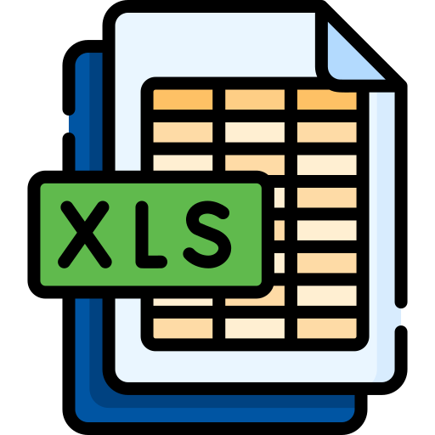
Big Data
Characteristics:
Size (Volume): from a few tens of terabytes to many petabytes in a single database.
Data model (Variety): structured (relational, tabular), semi-structured (JSON) or unstructured data (Web & log files).
Update Rate (Velocity): second to minute granularity.
Big Data is data that does not Fit In Excel! ☺
Big Data is data large enough to challenge our computational resources for processing and storage.

Slide 7



Data storage
Forecast [IDC’24]: Data will grow at a compound annual growth rate of 19.2% to reach more than 394 zettabytes by 2028
“If one were able to store 394 ZB onto BluRay discs,
then you’d have a stack of discs that can get you to the moon 49 times…
or can circle the Earth approximately 472 times …”

Slide 8

Challenges
Organizations collect more than they can!
probably they do not know what the “needles” look like
Hard to figure out the data and its use (applications)
Costly to transform the data into value (operators)
Data Scientist
Expensive to store and transfer the data (storage & indexing)
Notes:
Needles in a field full of haystacks

Slide 9
Solutions
Machine learning
Analyze and extract insights from large volumes of data
Identify patterns, trends, and anomalies
Data visualization
Represent complex data in a more intuitive and easily understandable form
Distributed computing
Processing of data across multiple computers
Reducing the time required to transform the data
Data Management & Compression Schemes
Size of data
Storage space required, speed of data transfer, and process the data (less I/O)
Data Decay tradeoffs data storage for accuracy

Slide 10
SIBACO: Signature Based Compression
SIBACO’s hypothesis is that multi-scheme data compression is more effective for complex big data by enabling incremental compression and partial decompression.
Multi-scheme data compression uses different compression schemes that are more effective to be used for different columns based on their type and data characteristics (signature).
SIBACO supports data-intensive applications, many of which need to be able to perform exact queries over stored data. Therefore, we are exploring only lossless compression techniques.
SMDB@ICDE ‘23
Notes:
Can we do better?

Slide 11
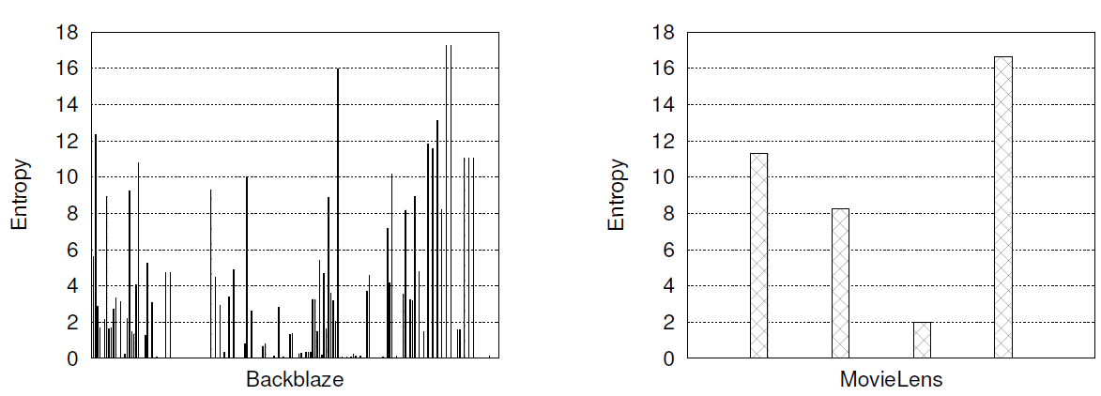
Compression & Entropy
The low-entropy attributes confirm that high compression ratios can be achieved.
The 0 entropy attributes are usually optional attributes for future use; thus, they are empty or not used, but still stored.

Slide 12

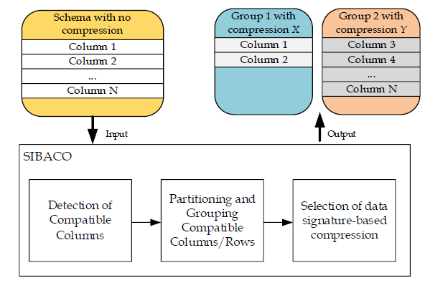
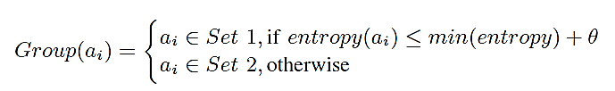
SIBACO Overview
Detection of compatible columns
The output of this stage is a table with the entropy of each column.
Partitioning and grouping of compatible columns/rows
The first group consists of the columns less than the threshold min(entropy) + θ, where θ is set based on empirical data (e.g., θ = 0.3).
The remaining columns with entropy greater than threshold form the 2nd group.
Selection of data type-based compression
Selects the most appropriate compression algorithm.
In an exhaustive way (e.g., test everything)
[F] Using a knowledge base with different data characteristics (e.g., entropy, data distribution and types).

Slide 13
Experimental Methodology
Compression Algorithms*:
Compared Techniques:
DEFLATED: uses a combination of LZ77 and Huffman coding.
BZIP2: uses a combination of the Burrows-Wheeler transform and Huffman coding.
LZMA: uses a combination of dictionary compression scheme, similar with LZ77, and arithmetic logic.
BASELINE: This is the baseline (“monolithic”) technique, which compresses the data being agnostic of the data characteristics. It compresses all the data with only a single compression scheme.
SIBACO-BASIC: This is the basic approach of our proposed technique that uses a single compression scheme.
SIBACO: This is our proposed technique that uses multiple compression schemes.
*We chose the following algorithms because they are good representatives of the compression categories and are readily available from the zipfile library.

Slide 14


Experiments: Datasets
Backblaze: (∼20GB)
MovieLens: (∼645MB)
This dataset is a subset of the publicly available hard drive metrics released by Backblaze. In our experiments we have only included data for the year 2022 (Q1-Q3). The data contains daily snapshots of more than 100.000 operational drives in a datacenter. The daily snapshot of each drive is represented by one row that captures basic drive metadata (i.e., serial number, device model, capacity) as well as SMART Attributes metrics. This dataset has 178 attributes and a total size of ∼20GB.
This dataset is a subset of the real-word MovieLens dataset collected by the GroupLens research laboratory. It contains 25 million ratings and one million tag applications applied to 62,000 movies by 162,000 users. This dataset has four attributes and and has a total size of ∼645MB.

Slide 15
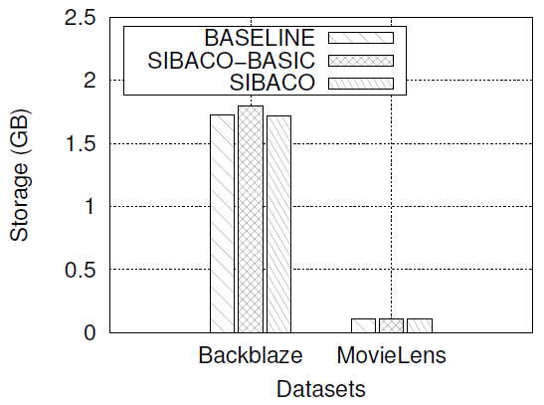
Experiments: Both Datasets
SIBACO (with multiple compression schemes) compares to the Baseline and SIBACO-BASIC approaches (that use a single compression scheme – BZIP2).
SIBACO selects the best performing compression schemes for a group based on the control experiments.
SIBACO achieves up to ∼4% better performance against BASELINE.
E.g., Dropbox has 17.77 million paying users
$9.99/month for 2 TB
$0.40/month savings
→ $7.1M per month
https://www.statista.com/statistics/819605/number-of-paying-dropbox-users/
Notes:
Calculation

Slide 16














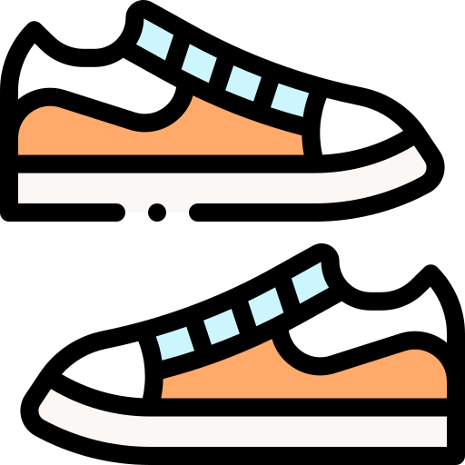
PLATCOM Concept
Sunny Data:
Simple and fast compression for simple data.
Rainy Data:
Better compression ratio for moderately complex data.
Snowy Data:
High compression ratio for complex and large datasets.
Just like a wardrobe adapts to weather and activities, COMPASS adapts to different characteristics of data.
Sunny Data | Rainy Data | Snowy Data
e.g., GZIP | e.g., BZIP | e.g., LZMA

Slide 17


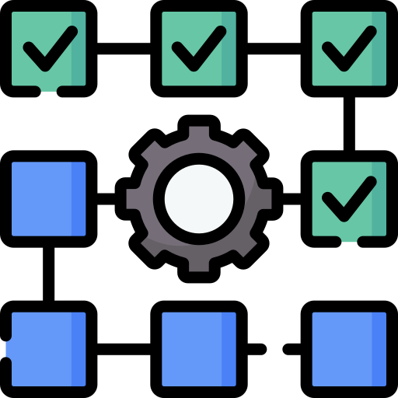


PLATCOM Workflow
1
2
3
4
[ Read Data ] [ Cluster by Signature ] [ Evaluate Compressors ] [ Store Best Settings ]
Scalable Clustering: Groups columns by actual data signatures (points, entropy, features).
Exhaustive Testing: Runs every compressor/cluster combo to find the true sweet spot.
Future-Proof Profiles: Persists chunk-level metadata for instant re-tuning as data evolves.

Slide 18

PLATCOM Workflow
From raw data to optimized storage—in four automated steps
1
2
3
4
| Read Data | |Profile & Cluster | |ML–Select Algo | | Store Compressed|
Automated at Scale: End-to-end pipeline can run on petabyte-scale tables with no manual tuning.
Data-Aware Intelligence: Profiles each chunk’s actual properties (points, entropy, features) before clustering.
Optimal Outcomes: ML-driven compressor choice yields up to 46 % more reduction vs. legacy and 7 % vs. state-of-the-art.

Slide 19
COMPASS/PLATCOM
Dynamically selects the best compressor per data chunk.
Up to 46% storage reduction against legacy systems.
7% better storage space compared to the state-of-the-art* (*this is an improved version of Timescale).
While traditional systems pick compressors by broad file-type, PLATCOM profiles each data chunk’s actual properties at scale—then automatically selects the optimal algorithm. No more one-size-fits-all guesses.
PLATCOM = Adaptive AI Compression for all data types

Slide 20
Outline
Introduction & Motivation
Big data architectures, apps & tools
PLATCOM
PLATDEC
Conclusions
Future work

Slide 21
How to Reduce Data?
Data Sampling
Uniform or Random Data < Original Data
Data Aggregation (Data Cubes)
Query Result Data < Original Data
Data Reduction (SVD, DFT, DWT)
Principal Components (Patterns) << Original Data
Data Synopsis (e.g. equiwidth/depth histograms, Bloom filters, sketches)
“Statistics” about Data << Original Data
Data Compression (lossless or lossy)
Combination of techniques, e.g., GZIP=DEFLATE(LZ77+HUFF)
Problem: None of the above considers how to outdate (decay) data as time elapses.

Slide 22
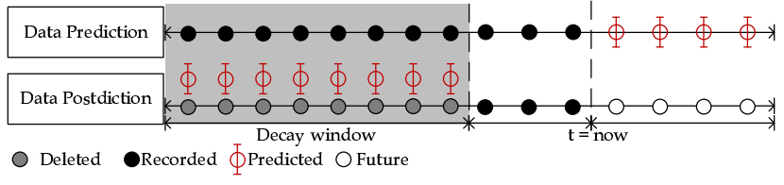
Data Postdiction
Data Postdiction (DP): aims to recover the past value of some tuple, which has been decayed for efficiency purposes, using a ML model.
Data Prediction: aims to make a statement about the future value of some tuple using a ML model.
GeoInformatica '19
MDM ‘18

Slide 23
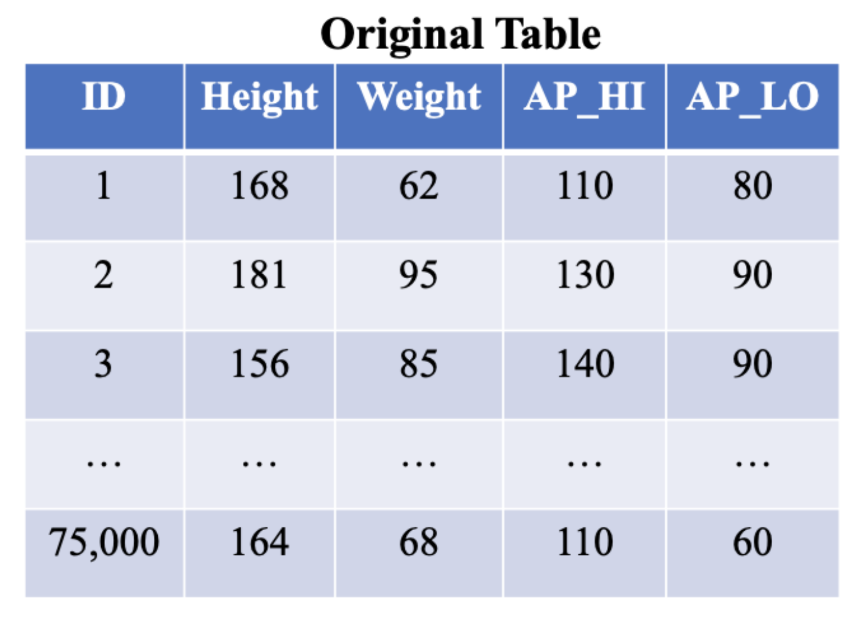
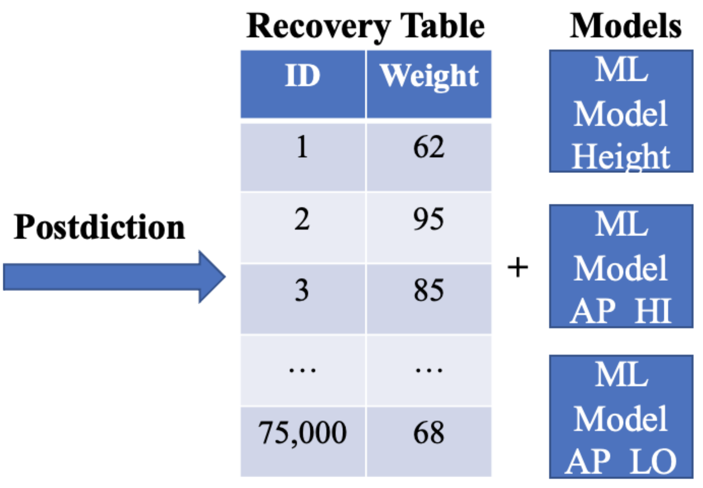
Data Postdiction Example
Ulianova, S.: Cardiovascular disease dataset (2019)

Slide 24
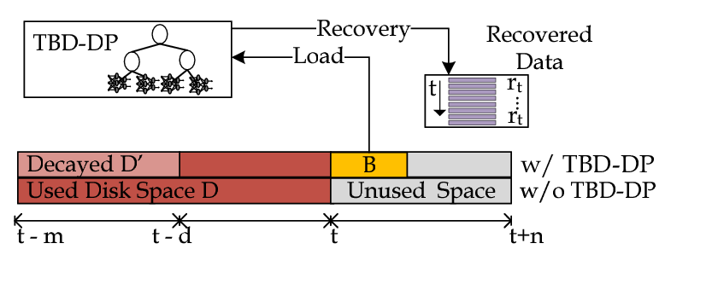
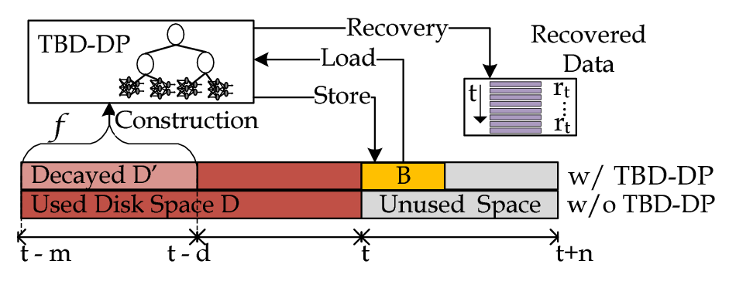
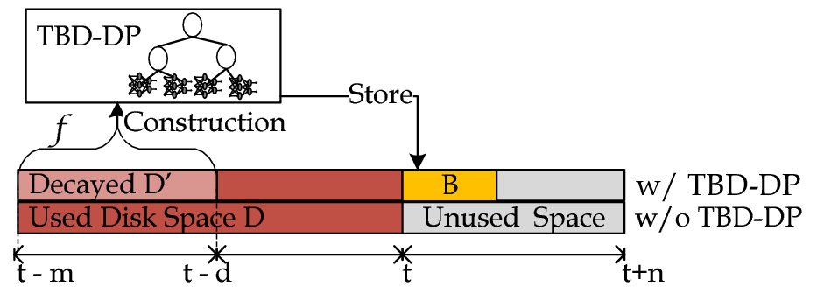
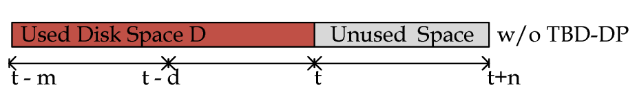
Decaying: DP Component
TBD-DP Component Overview
Construction algorithm: construct a DP-tree (B) for a percentage (f) of the historic data (D), denoted as D’.
Delete D’ and retain B for data recovery.
Recovery algorithm: use {B, D-D’} to recover any past data blocks, upon demand.
D = full data resolution and B = model data resolution

Slide 25
Experimental Methodology
To evaluate DP component, we have implemented a trace-driven experimental testbed:
Compared Approaches/Algorithms:
RAW: does not apply any decaying.
COMPRESSION: the decayed dataset is compressed with the GZIP library (used in SPATE @ ICDE’17)
SAMPLING: a consecutive sampling algorithm used for achieving a 50% sample size on the decayed dataset.
RANDOM: uniformly randomly select one record from the decayed dataset.
TBD-DP: the proposed technique in this work.
Metrics:
Storage Capacity(MB): the total space to store data and index
Normalized Root Mean Square Error: the error of the recovered data D′ using the well known NRMSE.
Notes:
TBD-DP: Models + (1-f)% of RAW dataset.

Slide 26
Experimental Datasets
We constructed 6 realistic KPI Queries based on an anonymized TBD dataset [ICDE17]:
Dataset: 3660 cells (CELL) coming from 2G, 3G and LTE antennas,100M NMS records, 300K users, ~10GB.
KPIs (Key Performance Indicators) Queries: Calls (CS), Call Drops (CSD), ThroughPut (TP), Handover Attempts (HA), Handovers (HS), Call Setup Attempts (CSA), Call Setups (CS)

Slide 27
Experimental Testbed
TBD Operating System Stack
Datacenter: VMWare ESXi 5.0.0 Hosts
VMs: 4 Ubuntu 14.04 server images, each featuring: 8GB of RAM with 2 virtual CPUs (2.40GHz)
Storage Element: Slow 7.2K RPM RAID-5 SAS, 6 Gbps disks. Each disk formatted in VMFS 5.54 (1MB block)
TBD Framework Stack
Hadoop Distributed File System (HDFS) v2.5.2
Apache Hive 2.0 (online querying)
Apache Spark 1.6.0 (offline data processing)
Python 3.6.3
Tensorflow 1.7 (LSTM, RNN, GRU)
SPARK Jobs
Apache HIVE Warehouse
Apache HDFS
Filesystem

Slide 28
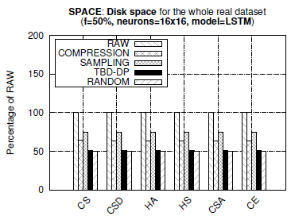
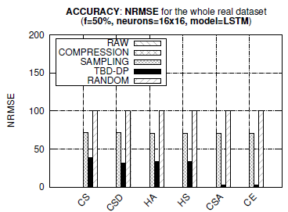
Space and Accuracy
Observations:
TBD-DP provides 25%, 50% better space capacity than COMPRESSION and RAW, respectively.
TBD-DP outperforms the SAMPLING approach by 50% in terms of NRMSE, on average, in all datasets.
COMPRESSION approach provides an optimal NRMSE = 0 (GZIP is lossless, but requires more space)
TBD-DP could have been configured with a decay factor f=100% rather than f=50%, yielding even less space (i.e., decay everything, retain only model approach)

Slide 29
Postdiction Pipeline
Input
Data Decay
Output
Outlier Table
Recovery Table
ML Models
Storage Size
Recovered Accuracy
Data
Error Tolerance / Accuracy
Clustering
ML
Accuracy Tuning
Outlier Detection
Current implementation:
Outlier Detection: Z-score, Isolation Forest
Clustering: K-means, Density-based spatial clustering (DBSCAN), Gaussian Mixture Modelling (GMM)
Machine Learning: LSTM
ADBIS ‘23

Slide 30
Outlier Detection
ID | Height | Weight
1 | 168 | 62
Outlier Table
2 | 181 | 59
ID | Height | Weight
3 | 156 | 85
4 | 133 | 60
5 | 178 | 90
6 | 175 | 91
7 | 166 | 68
8 | 159 | 72
9 | 166 | 62
10 | 170 | 83
11 | 171 | 95
12 | 140 | 65

Slide 31
Clustering
ID | Height | Weight
ID | Height | Weight
3 | 156 | 85
1 | 168 | 62
3 | 156 | 85
5 | 178 | 90
Outlier Table
6 | 175 | 91
4 | 133 | 60
ID | Height | Weight
7 | 166 | 68
5 | 178 | 90
2 | 181 | 59
8 | 159 | 72
6 | 175 | 91
11 | 171 | 95
13 | 164 | 68
7 | 166 | 68
8 | 159 | 72
ID | Height | Weight
Pipeline | Num. Models | Num. Outliers | Recovered Accuracy
No Clustering / Outlier Detection | 1 | 0 | 18.7425
Clustering Only | 2 | 0 | 30.97082
Outlier Detection Before Clustering | 2 | 14301 | 47.43767
9 | 166 | 62
1 | 168 | 62
10 | 170 | 83
4 | 133 | 60
12 | 140 | 65
9 | 166 | 62
13 | 164 | 68
10 | 170 | 83
Outlier detection: Z-score
Clustering: K-means
*Recovered accuracy = percent of samples within designated error threshold (5%)
12 | 140 | 65

Slide 32
Accuracy Tuning
ID | Height | Weight | Pred. Error
3 | 156 | 85 | 4%
Outlier Table
5 | 178 | 90 | 4%
ID | Height | Weight
6 | 175 | 91 | 1%
2 | 181 | 59
7 | 166 | 68 | 3%
11 | 171 | 95
8 | 159 | 72 | 1%
13 | 164 | 68 | 2%
ID | Height | Weight | Pred. Error
Pipeline | Num. Models | Num. Outliers | Recovered Accuracy
No Clustering / Outlier Detection | 1 | 0 | 18.7425
Clustering + Accuracy Tuning | 2 | 18036 | 100.00
Outlier Detection Before & After Clustering + Accuracy Tuning | 2 | 28064 | 100.00
1 | 168 | 62 | 4%
4 | 133 | 60
4 | 133 | 60 | 10%
9 | 166 | 62 | 4%
10 | 170 | 83 | 2%

Slide 33

Final Output
Recovery Tables
ID | Height
ID | Height
3 | 156
Machine Learning Models
1 | 168
3 | 156
Outlier Table
5 | 178
ID | Height | Weight
6 | 175
4 | 133
7 | 166
2 | 181 | 59
5 | 178
8 | 159
11 | 171 | 95
6 | 175
4 | 133 | 60
13 | 164
12 | 140 | 65
7 | 166
12 | 140 | 65
ID | Height
9 | 166
Output Statistics
1 | 168
10 | 170
Recovered Accuracy: 100%
Percent Outliers: 30.77%
9 | 166
10 | 170

Slide 34
Multi-Column Deletion
Database Schema
Age (16 bits)
Height (16 bits)
Weight (32 bits)
AP_HI (16 bits)
AP_LO (16 bits)
Cholesterol (2 bits)
Gluc (2 bits)
Smoke (1 bit)
Alco (1 bit)
Active (1 bit)
Cardio (1 bit)
Question:
For each column, how many other columns can it predict with an outlier table under 25% the original table size?
Best result:
AP_HI estimating Age and Height
Outlier Table and Recovery Table 82.59% of the original table size

Slide 35
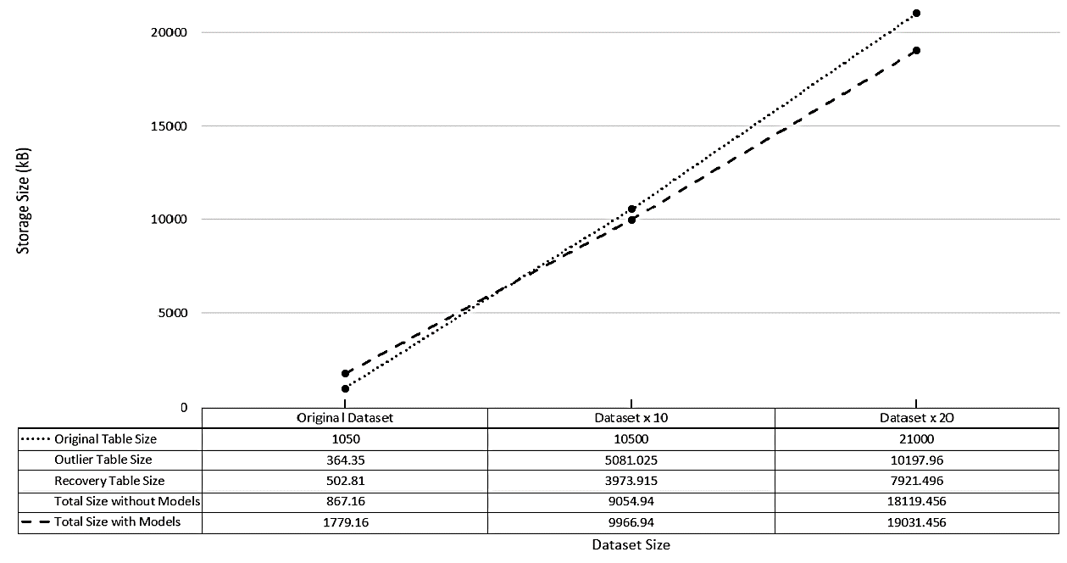
Applicability of Postdiction & Scaling
Inflection Point

Slide 36
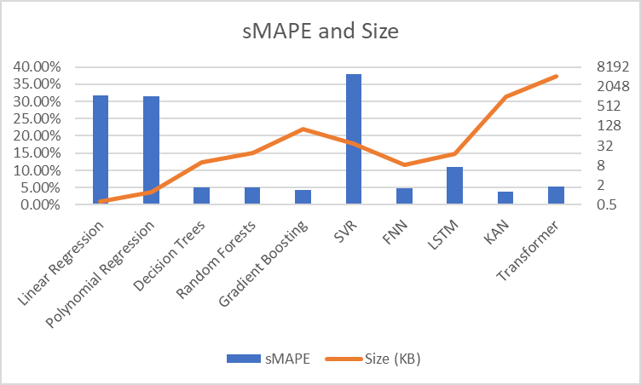
PLATDEC
Linear & Polynomial Regression
- Fast, but high error (sMAPE ~31%).
Tree-based Models
- Low sMAPE (≤5.2%), efficient size.
Deep Learning Models
- Good accuracy (KAN best at 3.9% sMAPE), but larger size and longer training time.
Transformer
- Strong performance (5.23% sMAPE) but heavy (4263 KB, 2412s training).
Description: Power consumption records in residential houses
Rows: 1,000,000
Features: 12
Predicted column size: ~6 MB

Slide 37
Outline
Introduction & Motivation
Big data architectures, apps & tools
PLATCOM
PLATDEC
Conclusions
Future work

Slide 38

Conclusions & Future Work
Exploit big data architectures & knowhow to support new big data applications.
Extend the functionality of the postdiction pipeline.
Enhance PLATCOM & PLATDEC with new ML models.
PLATCOM is using Random Forest Decision Trees to decide the best compression scheme.
PLATDEC is currently at the basic research stage.
Integrate our storage, indexing, and postidiction techniques into a big data platform that can support big data applications.
“Enable organizations to find the needles in a field of haystacks”

Slide 39

Advancing Big Data Storage with Machine Learning at Rinnoco Ltd
Constantinos Costa
costa.c@rinnoco.com
Co-founder & CEO,
Rinnoco Ltd
https://costadb.com
Thanks! Questions?
September 17, 2025
FSK 2025

