Slide 1


Innovative Big Data Tools and Systems for Data Storage Efficiency
Constantinos Costa
costa.c@rinnoco.com
Co-founder & CEO,
Rinnoco Ltd
https://costadb.com
January 10, 2025
University Of Pittsburgh

Slide 2
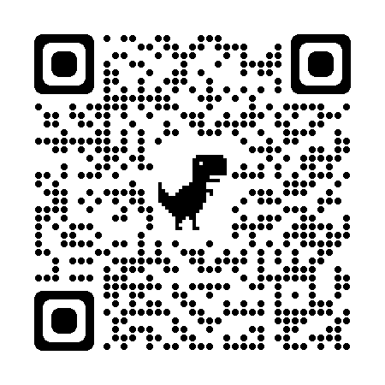
Who we are
Rinnoco Ltd is a research, innovation, and education consulting company, which enables the development of new unique products from design to deployment targeting international markets.
Rinnoco was founded in 2021 and it is based in Limassol, Cyprus.
You can find more details on our website (https://rinnoco.com/).

Slide 3
What we do
We want to build products inspired from my PhD research and our academic background. Rinnoco focuses on creating data storage tools and platforms that can reduce the storage space utilizing state-of-the-art techniques.
We are building two software tools as the first part of our long-term plan. The two tools are:
  A Signature Based Compression tool
  A Data decay tool

Slide 4
Outline
Introduction & Motivation
Big data architectures, apps & tools
  SPATE
  SIBACO/COMPASS
  Data Postdiction
  Decay Pipeline
Conclusions
Future work

Slide 5
Big Data Applications
New applications operate on big data!
Social
Spatiotemporal
Spatial

Slide 6
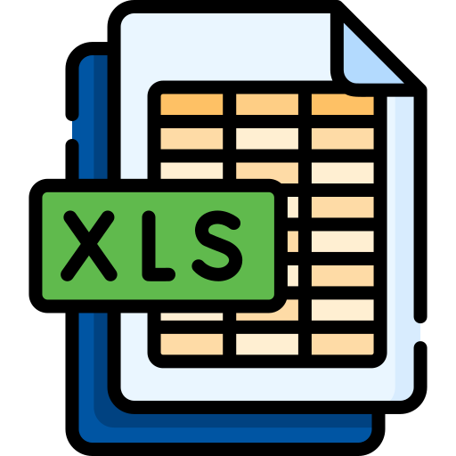
Big Data
Characteristics:
  Size (Volume): from a few tens of terabytes to many petabytes in a single database.
  Data model (Variety): structured (relational, tabular), semi-structured (JSON) or unstructured data (Web & log files).
  Update Rate (Velocity): second to minute granularity.
Big Data is data that does not Fit In Excel! ☺
Big Data is data large enough to challenge our computational resources for processing and storage.

Slide 7



Data storage
Forecast [IDC’24]: data will grow at a compound annual growth rate of 19.2% to reach more than 394 zettabytes by 2028
“If one were able to store 394 ZB onto BluRay discs,
then you’d have a stack of discs that can get you to the moon 49 times…
or can circle the Earth approximately 472 times …”

Slide 8

Challenges
Organizations collect more than they can!
  probably they do not know what the “needles” look like
Hard to figure out the data and its use (applications)
Costly to transform the data into value (operators)
Data Scientist
Expensive to store and transfer the data (storage & indexing)
Notes:
Needles in a field full of haystacks

Slide 9
Solutions
Machine learning
  Analyze and extract insights from large volumes of data
  Identify patterns, trends, and anomalies
Data visualization
  Represent complex data in a more intuitive and easily understandable form
Distributed computing
  Processing of data across multiple computers
  Reducing the time required to transform the data
Data Management & Compression Schemes
  Size of data
  Storage space required, speed of data transfer, and process the data (less I/O)
  Data Decay tradeoffs data storage for accuracy

Slide 10
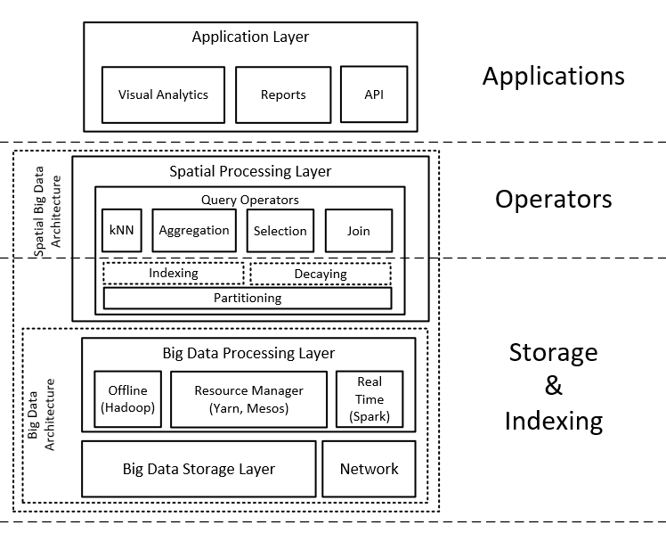
Spatial Big Data (SBD) Architecture

Slide 11
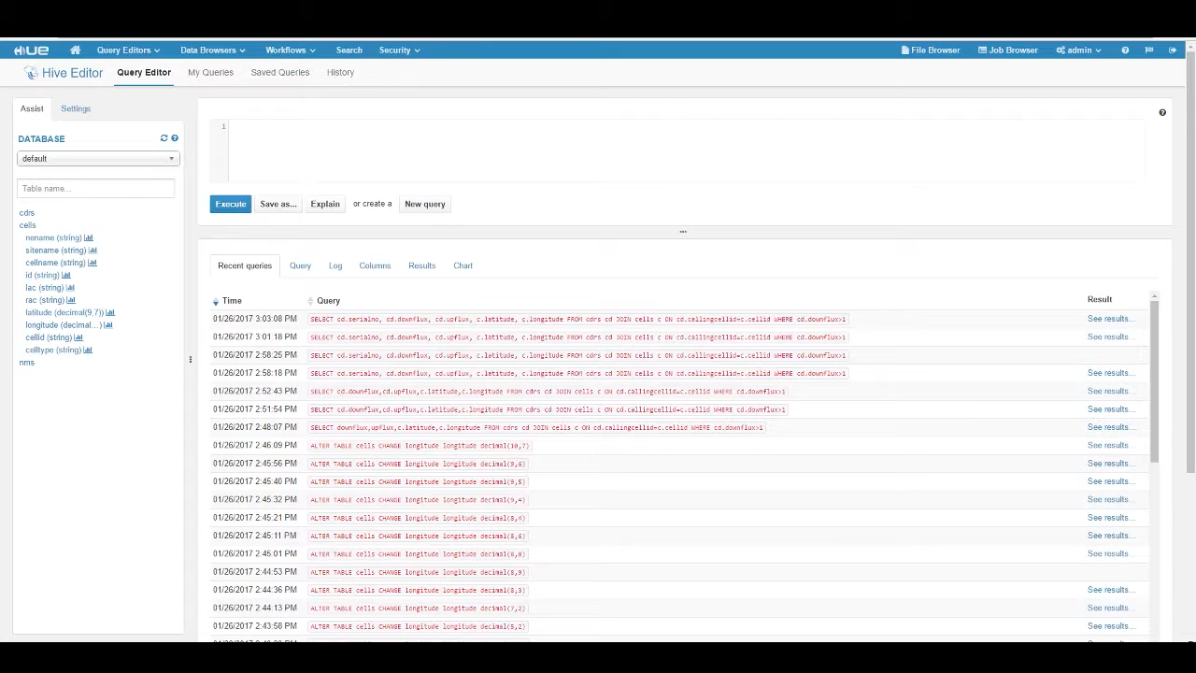
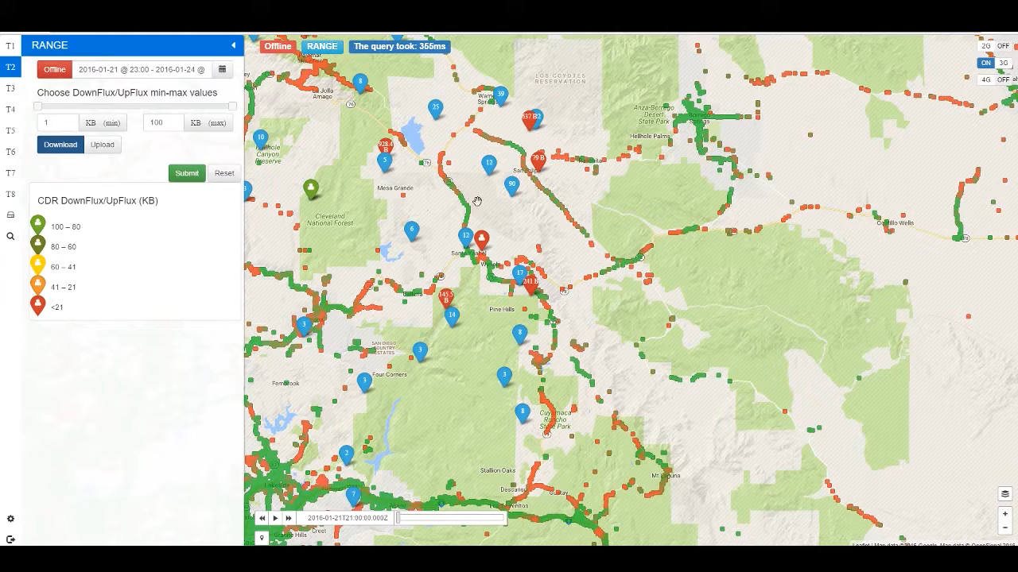
SPATE: Telco SBD
The SPATE UI over the San Diego area with data from https://www.cellmapper.net/map
ICDE '17
MDM ‘18
BIRTE@VLDB ‘17

Slide 12
Telco SBD
Telco Data: Traditional source for OLAP Data Warehouses and Analytics.
  e.g., Accounting, Billing, Session data.
  Problem: Inadequate data resolution to address biggest challenges:
    e.g., churn prediction, 5G network optimization, user-experience assessment, traffic mapping.
Telco SBD (TBD): Velocity data generated at the cell towers.
  e.g., signal strength, call drops, bandwidth measurements.
  Size: 5TBs/day for 10M clients (i.e., 2PB/year).
RDBMS
Data Store

Slide 13
Compression
Compression refers to the encoding of data using fewer bits than the original representation
Benefits:
  Shifts the resource bottlenecks from storage- and network-I/O to CPU (cycles increasing faster).
  Save enormous amounts of storage and I/O on subsequent analytic tasks!
Target: Given a setting where SBD arrives periodically in batches, we want to:
  minimize the space needed to store/archive data
  minimize response time for spatiotemporal data exploration queries

Slide 14
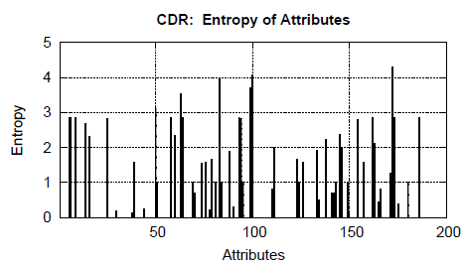
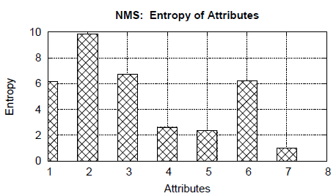
Compression
We analyzed an anonymized real TBD dataset to understand what compression ratios can be achieved.
  Dataset: 1 week, 1.7M CDR, 21M NMS, 300K users
  Tool: Shannon’s entropy (typical measure for the maximum compressibility of a dataset)
  Observation: TBD contains significant redundancy (Entropy close to 0)!

Slide 15
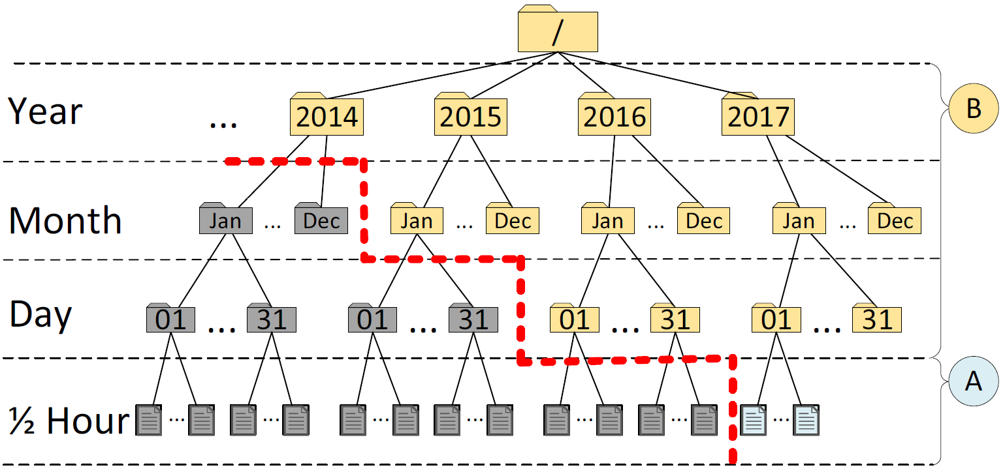
Decaying
Data Decaying refers to the “progressive loss of detail in information as data ages with time until it has completely disappeared.”
  M. L. Kersten, “Big data space fungus,” @ CIDR’15
  Examples: FIFO Decay, Uniform Decay, Random Decay, Exponential Time Decay, etc.
Benefits:
  Retain same data exploration capabilities.
  Save enormous amounts of storage and I/O.
Alternative definition referring to DB Schema Decay also exists, but it is not applicable here.
  M. Stonebraker, R. Castro, F. Dong Deng, and M. Brodie, “Database decay and what to do about it.” 2016. [Online]. BLOG@CACM: https://goo.gl/tJNa9m.

Slide 16
Indexing: Incremence
Our spatio-temporal index has 4 levels of temporal resolutions
  epoch (30 minutes), day, month, year.
Incremence Module
  Add compressed snapshots on the right-most path

Slide 17
Highlights
Highlights Module
  materialized views to long-standing queries of users (e.g., the drop-call counters, bandwidth statistics, etc.)
  essential for multi-granular visual analytics!

Slide 18
Indexing: Decaying (First Idea)
Decaying Module
  Data Fungus: “Evict Oldest Individuals”
  More Data Fungus are investigated in the next slides

Slide 19
Experimental Methodology
To evaluate SPATE, we have implemented a trace-driven experimental testbed:
Compared Frameworks:
  RAW: stores the snapshot on disk without compression or indexing
  SHAHED: stores the snapshot using a quad-tree index (part of the offlline analytic SpatialHadoop 2.4 framework @ ICDE’15).
  SPATE: the proposed framework in this work.
Metrics:
  Ingestion Time (sec): time to store a 30-min TBD snapshot
  Space (MB): space to store a 30-min TBD snapshot
  Response Time (sec): time to answer a query.

Slide 20
Experimental Testbed
TBD Operating System Stack
  Datacenter: VMWare ESXi 5.0.0 Hosts
  VMs: 4 Ubuntu 14.04 server images, each featuring: 8GB of RAM with 2 virtual CPUs (2.40GHz)
  Storage Element: Slow 7.2K RPM RAID-5 SAS, 6 Gbps disks. Each disk formatted in VMFS 5.54 (1MB block)
TBD Framework Stack
  Hadoop Distributed File System (HDFS) v2.5.2
  Apache Hive 2.0 (online querying)
  Apache Spark 1.6.0 (offline data processing)
    Individual Scala programs submitted directly to the Spark computation master
SPARK Jobs
Apache HIVE Warehouse
Apache HDFS
Filesystem

Slide 21
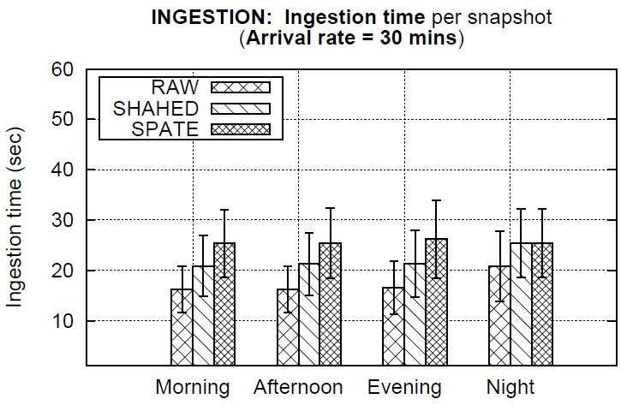
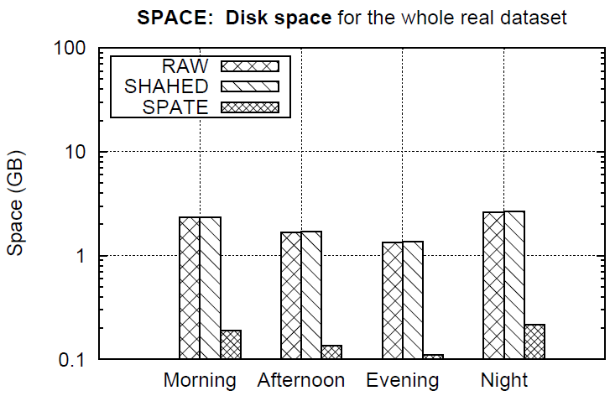
Ingestion Time and Space
Ingestion time (left) and Space (right) of methods over different time windows within a day.
Observation: SPATE 1.25x slower in ingestion but needs 1 order of magnitude less storage space!
  Ingestions are separated by 30 minute windows, so this is acceptable.

Slide 22
Outline
Introduction & Motivation
Big data architectures, apps & tools
  SPATE
  SIBACO/COMPASS
  Data Postdiction
  Decay Pipeline
Conclusions
Future work

Slide 23
SIBACO: Signature Based Compression
SIBACO’s hypothesis is that multi-scheme data compression is more effective for complex big data by enabling incremental compression and partial decompression.
Multi-scheme data compression uses different compression schemes that are more effective to be used for different columns based on their type and data characteristics (signature).
  SIBACO supports data-intensive applications, many of which need to be able to perform exact queries over stored data. Therefore, we are exploring only lossless compression techniques.
SMDB@ICDE ‘23
Notes:
Can we do better?

Slide 24
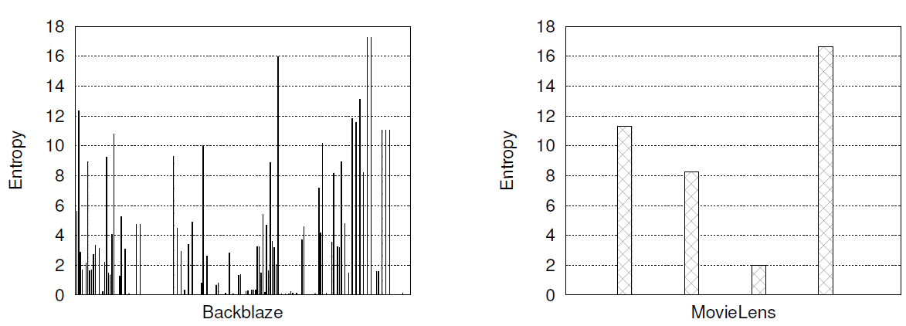
Compression & Entropy
The low-entropy attributes confirm that high compression ratios can be achieved.
The 0 entropy attributes are usually optional attributes for future use, thus they are empty or not used, but still stored.

Slide 25

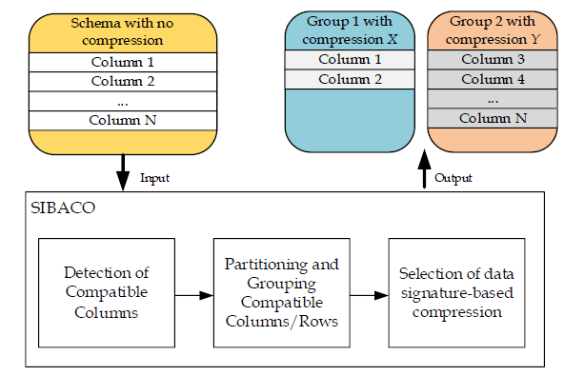
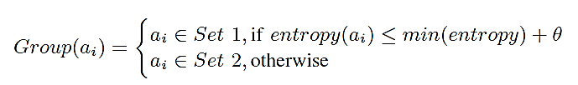
SIBACO Overview
Detection of compatible columns
  The output of this stage is a table with the entropy of each column.
Partitioning and grouping of compatible columns/rows
  The first group consists of the columns less than the threshold min(entropy) + θ, where θ is set based on empirical data (e.g., θ = 0.3).
  The remaining columns with entropy greater than threshold form the 2nd group.
Selection of data type-based compression
  Selects the most appropriate compression algorithm.
    In an exhaustive way (e.g., test everything)
    [F] Using a knowledge base with different data characteristics (e.g., entropy, data distribution and types).

Slide 26
Experimental Methodology
Compression Algorithms*:
Compared Techniques:
DEFLATED: uses a combination of LZ77 and Huffman coding.
BZIP2: uses a combination of the Burrows-Wheeler transform and Huffman coding.
LZMA: uses a combination of dictionary compression scheme, similar with LZ77, and arithmetic logic.
BASELINE: This is the baseline (“monolithic”) technique, which compresses the data being agnostic of the data characteristics. It compresses all the data with only a single compression scheme.
SIBACO-BASIC: This is the basic approach of our proposed technique that uses a single compression scheme.
SIBACO: This is our proposed technique that uses multiple compression schemes.
*We chose the following algorithms because they are good representatives of the compression categories and are readily available from the zipfile library.

Slide 27


Experiments: Datasets
Backblaze: (∼20GB)
MovieLens: (∼645MB)
This dataset is a subset of the publicly available hard drive metrics released by Backblaze. In our experiments we have only included data for the year 2022 (Q1-Q3). The data contains daily snapshots of more than 100.000 operational drives in a datacenter. The daily snapshot of each drive is represented by one row that captures basic drive metadata (i.e., serial number, device model, capacity) as well as SMART Attributes metrics. This dataset has 178 attributes and a total size of ∼20GB.
This dataset is a subset of the real-word MovieLens dataset collected by the GroupLens research laboratory. It contains 25 million ratings and one million tag applications applied to 62,000 movies by 162,000 users. This dataset has four attributes and and has a total size of ∼645MB.

Slide 28
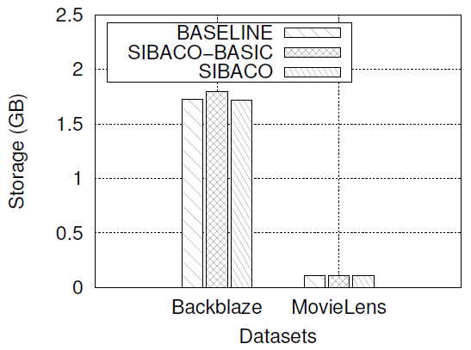
Experiments: Both Datasets
SIBACO (with multiple compression schemes) compares to the Baseline and SIBACO-BASIC approaches (that use a single compression scheme – BZIP2).
SIBACO selects the best performing compression schemes for a group based on the control experiments.
SIBACO achieves up to ∼4% better performance against BASELINE.
E.g., Dropbox has 17.77 million paying users
  $9.99/month for 2 TB
  $0.40/month savings
→ $7.1M per month
https://www.statista.com/statistics/819605/number-of-paying-dropbox-users/
Notes:
Calculation

Slide 29















COMPASS
Sunny Data:
  Simple and fast compression for less complex data.
Rainy Data:
  Better compression ratio for moderately complex data.
Snowy Data:
  High compression ratio for complex and large datasets.
Just like a wardrobe adapts to weather and activities, COMPASS adapts to different characteristics of data.
Sunny Data | Rainy Data | Snowy Data
e.g., GZIP | e.g., BZIP | e.g., LZMA

Slide 30
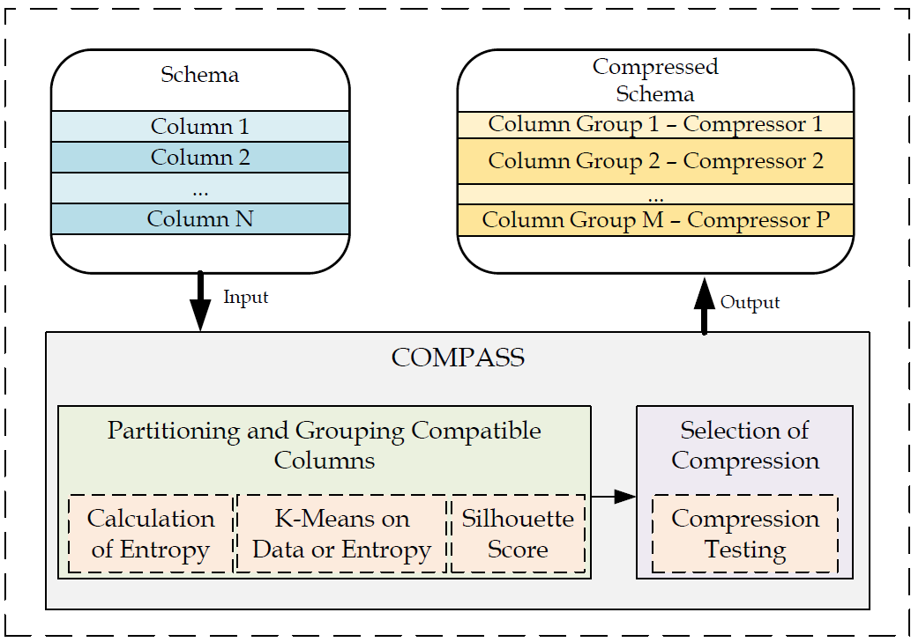
COMPASS Overview

Slide 31



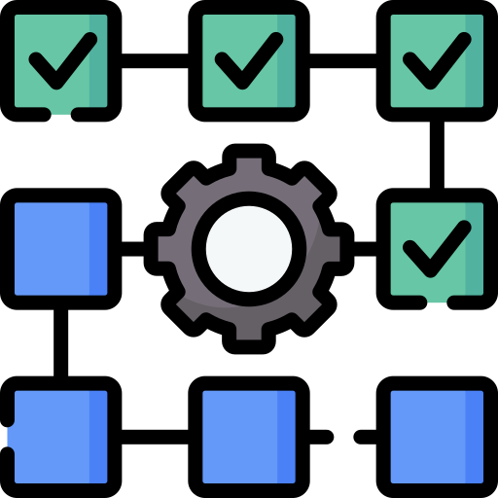

COMPASS Setup
Read the data from the database
Cluster the columns based on:
  All the data points
  Entropy
  Features (select specific features)
Test all the possible combinations
  Number of Clusters
  Compression Algorithms (E.G., GZIP, ZSTD, LZMA, BZIP)
Results
  This allows us to figure out all the parameters and features that we can use in the future
1
2
3
4

Slide 32

COMPASS in Action
Read the data from the database and pass the information gathered during the setup
Build/Load a ML model to decide:
  The number of clusters
  Features
  Compression Algorithm
Cluster the columns based on:
  Features (select specific features)
  All the data points
  Entropy
Store the data in a compressed manner back to the DBMS
1
2
3
4

Slide 33
Outline
Introduction & Motivation
Big data architectures, apps & tools
  SPATE
  SIBACO/COMPASS
  Data Postdiction
  Decay Pipeline
Conclusions
Future work

Slide 34
How to Reduce Data?
Data Sampling
  Uniform or Random Data < Original Data
Data Aggregation (Data Cubes)
  Query Result Data < Original Data
Data Reduction (SVD, DFT, DWT)
  Principal Components (Patterns) << Original Data
Data Synopsis (e.g. equiwidth/depth histograms, Bloom filters, sketches)
  “Statistics” about Data << Original Data
Data Compression (lossless or lossy)
  Combination of techniques, e.g., GZIP=DEFLATE(LZ77+HUFF)
Problem: None of the above considers how to outdate (decay) data as time elapses.

Slide 35
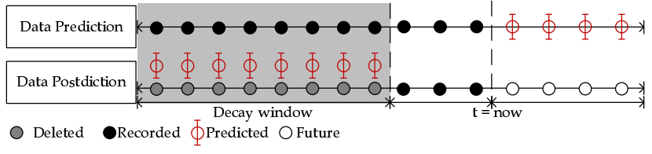
Data Postdiction
Data Postdiction (DP): aims to recover the past value of some tuple, which has been decayed for efficiency purposes, using a ML model.
  Data Prediction: aims to make a statement about the future value of some tuple using a ML model.
GeoInformatica '19
MDM ‘18
Storage

Slide 36
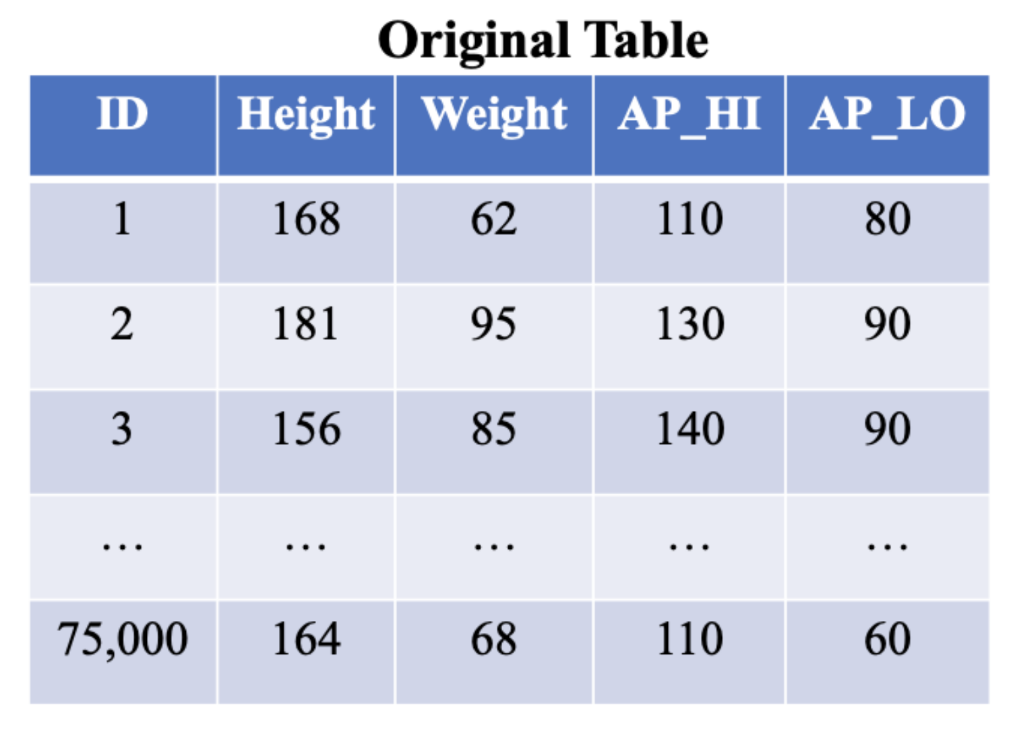
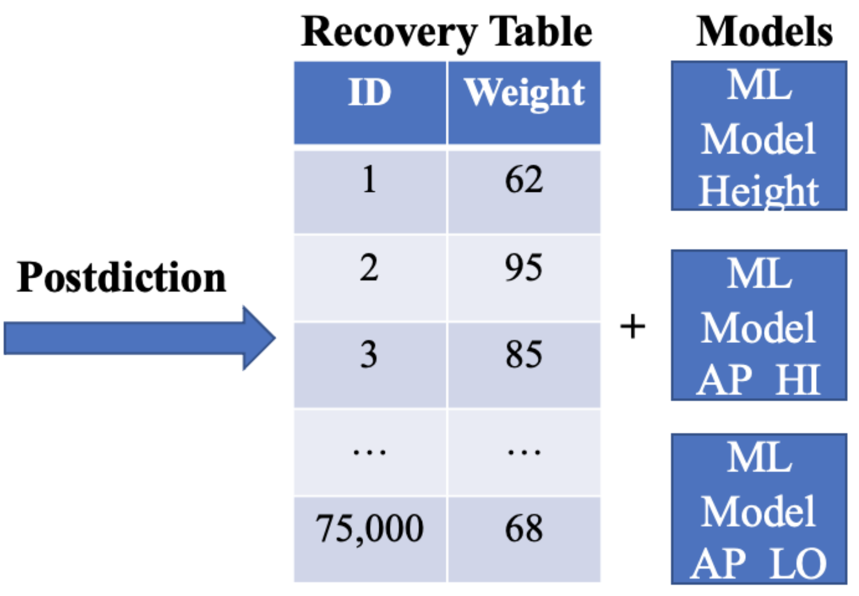
Data Postdiction Example
Ulianova, S.: Cardiovascular disease dataset (2019)

Slide 37
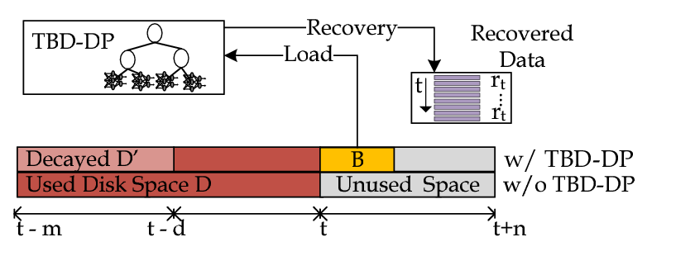
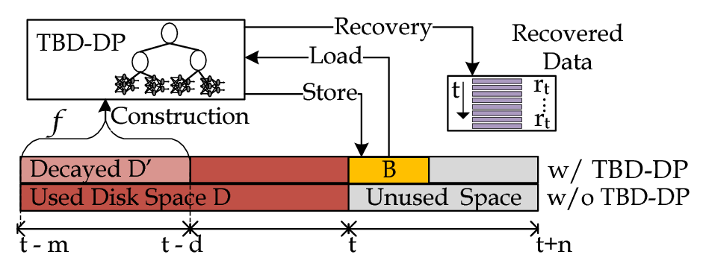
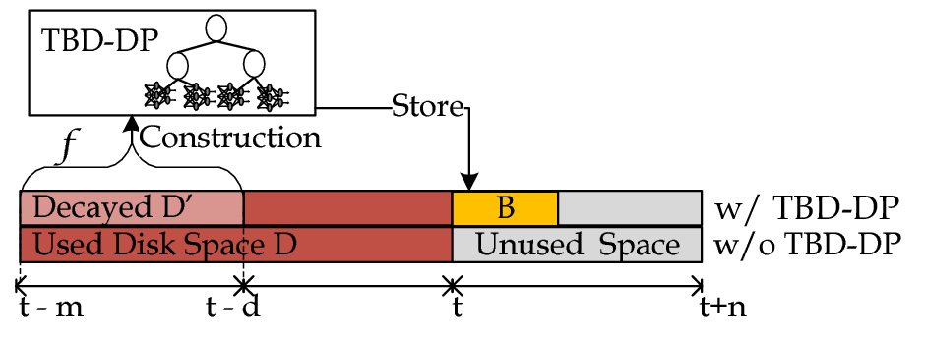
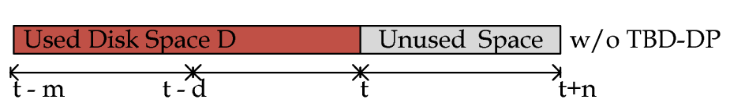
Decaying: TBD-DP Component
TBD-DP Component Overview
  Construction algorithm: construct a DP-tree (B) for a percentage (f) of the historic data (D), denoted as D’.
    Delete D’ and retain B for data recovery.
  Recovery algorithm: use {B, D-D’} to recover any past data blocks, upon demand.
    D = full data resolution and B = model data resolution

Slide 38
Experimental Methodology
To evaluate TBD-DP component, we have implemented a trace-driven experimental testbed:
  Compared Approaches/Algorithms:
    RAW: does not apply any decaying.
    COMPRESSION: the decayed dataset is compressed with the GZIP library (used in SPATE @ ICDE’17)
    SAMPLING: a consecutive sampling algorithm used for achieving a 50% sample size on the decayed dataset.
    RANDOM: uniformly randomly select one record from the decayed dataset.
    TBD-DP: the proposed technique in this work.
  Metrics:
    Storage Capacity(MB): the total space to store data and index
    Normalized Root Mean Square Error: the error of the recovered data D′ using the well known NRMSE.
Notes:
TBD-DP: Models + (1-f)% of RAW dataset.

Slide 39
Experimental Datasets
We constructed 6 realistic KPI Queries based on an anonymized TBD dataset [ICDE17]:
  Dataset: 3660 cells (CELL) coming from 2G, 3G and LTE antennas,100M NMS records, 300K users, ~10GB.
  KPIs (Key Performance Indicators) Queries: Calls (CS), Call Drops (CSD), ThroughPut (TP), Handover Attempts (HA), Handovers (HS), Call Setup Attempts (CSA), Call Setups (CS)

Slide 40
Experimental Testbed
TBD Operating System Stack
  Datacenter: VMWare ESXi 5.0.0 Hosts
  VMs: 4 Ubuntu 14.04 server images, each featuring: 8GB of RAM with 2 virtual CPUs (2.40GHz)
  Storage Element: Slow 7.2K RPM RAID-5 SAS, 6 Gbps disks. Each disk formatted in VMFS 5.54 (1MB block)
TBD Framework Stack
  Hadoop Distributed File System (HDFS) v2.5.2
  Apache Hive 2.0 (online querying)
  Apache Spark 1.6.0 (offline data processing)
  Python 3.6.3
  Tensorflow 1.7 (LSTM, RNN, GRU)
SPARK Jobs
Apache HIVE Warehouse
Apache HDFS
Filesystem

Slide 41
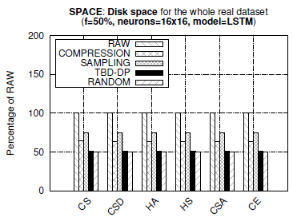
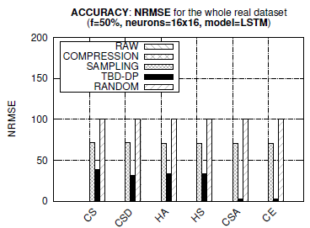
Space and Accuracy
Observations:
  TBD-DP provides 25%, 50% better space capacity than COMPRESSION and RAW, respectively.
  TBD-DP outperforms the SAMPLING approach by 50% in terms of NRMSE, on average, in all datasets.
  COMPRESSION approach provides an optimal NRMSE = 0 (GZIP is lossless, but requires more space)
  TBD-DP could have been configured with a decay factor f=100% rather than f=50%, yielding even less space (i.e., decay everything, retain only model approach)

Slide 42
Postdiction Pipeline
Input
Data Decay
Output
Outlier Table
Recovery Table
ML Models
Storage Size
Recovered Accuracy
Data
Error Tolerance / Accuracy
Clustering
ML
Accuracy Tuning
Outlier Detection
Current implementation:
Outlier Detection: Z-score, Isolation Forest
Clustering: K-means, Density-based spatial clustering (DBSCAN), Gaussian Mixture Modelling (GMM)
Machine Learning: LSTM
ADBIS ‘23

Slide 43
Outlier Detection
ID | Height | Weight
1 | 168 | 62
Outlier Table
2 | 181 | 59
ID | Height | Weight
3 | 156 | 85
4 | 133 | 60
5 | 178 | 90
6 | 175 | 91
7 | 166 | 68
8 | 159 | 72
9 | 166 | 62
10 | 170 | 83
11 | 171 | 95
12 | 140 | 65

Slide 44
Clustering
ID | Height | Weight
ID | Height | Weight
3 | 156 | 85
1 | 168 | 62
3 | 156 | 85
5 | 178 | 90
Outlier Table
6 | 175 | 91
4 | 133 | 60
ID | Height | Weight
7 | 166 | 68
5 | 178 | 90
2 | 181 | 59
8 | 159 | 72
6 | 175 | 91
11 | 171 | 95
13 | 164 | 68
7 | 166 | 68
8 | 159 | 72
ID | Height | Weight
Pipeline | Num. Models | Num. Outliers | Recovered Accuracy
No Clustering / Outlier Detection | 1 | 0 | 18.7425
Clustering Only | 2 | 0 | 30.97082
Outlier Detection Before Clustering | 2 | 14301 | 47.43767
9 | 166 | 62
1 | 168 | 62
10 | 170 | 83
4 | 133 | 60
12 | 140 | 65
9 | 166 | 62
13 | 164 | 68
10 | 170 | 83
Outlier detection: Z-score
Clustering: K-means
  *Recovered accuracy = percent of samples within designated error threshold (5%)
12 | 140 | 65

Slide 45
Accuracy Tuning
ID | Height | Weight | Pred. Error
3 | 156 | 85 | 4%
Outlier Table
5 | 178 | 90 | 4%
ID | Height | Weight
6 | 175 | 91 | 1%
2 | 181 | 59
7 | 166 | 68 | 3%
11 | 171 | 95
8 | 159 | 72 | 1%
13 | 164 | 68 | 2%
ID | Height | Weight | Pred. Error
Pipeline | Num. Models | Num. Outliers | Recovered Accuracy
No Clustering / Outlier Detection | 1 | 0 | 18.7425
Clustering + Accuracy Tuning | 2 | 18036 | 100.00
Outlier Detection Before & After Clustering + Accuracy Tuning | 2 | 28064 | 100.00
1 | 168 | 62 | 4%
4 | 133 | 60
4 | 133 | 60 | 10%
9 | 166 | 62 | 4%
10 | 170 | 83 | 2%

Slide 46

Final Output
Recovery Tables
ID | Height
ID | Height
3 | 156
Machine Learning Models
1 | 168
3 | 156
Outlier Table
5 | 178
ID | Height | Weight
6 | 175
4 | 133
7 | 166
2 | 181 | 59
5 | 178
8 | 159
11 | 171 | 95
6 | 175
4 | 133 | 60
13 | 164
12 | 140 | 65
7 | 166
12 | 140 | 65
ID | Height
9 | 166
Output Statistics
1 | 168
10 | 170
Recovered Accuracy: 100%
Percent Outliers: 30.77%
9 | 166
10 | 170

Slide 47
Multi-Column Deletion
Database Schema
Age (16 bits)
Height (16 bits)
Weight (32 bits)
AP_HI (16 bits)
AP_LO (16 bits)
Cholesterol (2 bits)
Gluc (2 bits)
Smoke (1 bit)
Alco (1 bit)
Active (1 bit)
Cardio (1 bit)
  Question:
    For each column, how many other columns can it predict with an outlier table under 25% the original table size?
Best result:
  AP_HI estimating Age and Height
  Outlier Table and Recovery Table 82.59% of the original table size

Slide 48
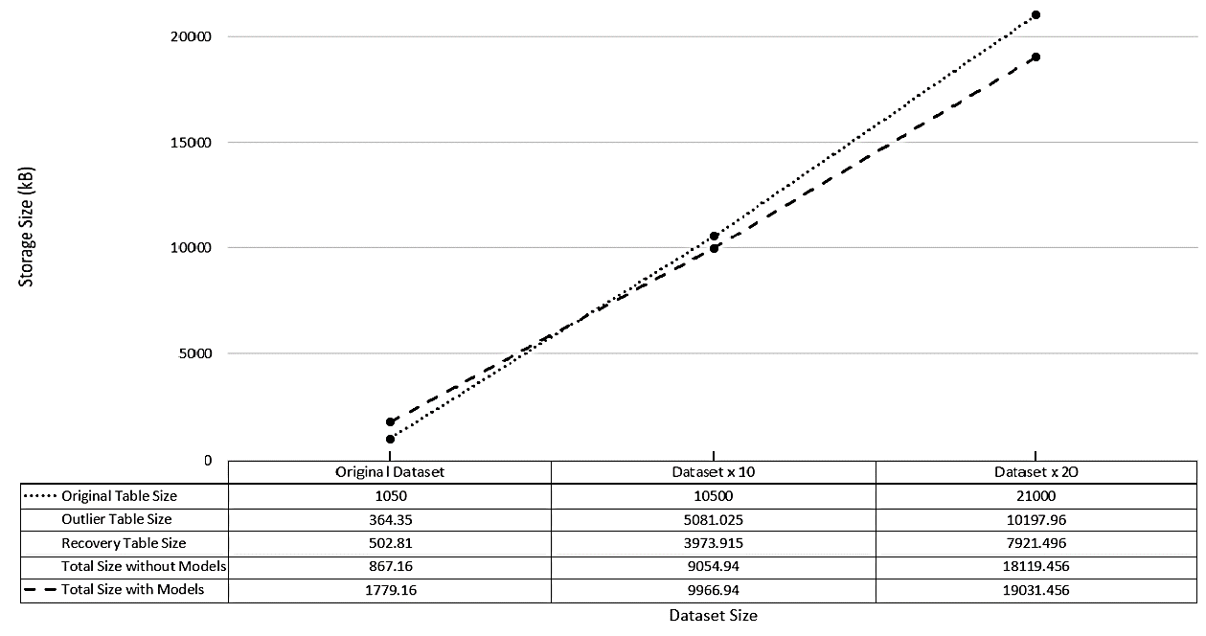
Applicability of Postdiction & Scaling
Inflection Point

Slide 49
Outline
Introduction & Motivation
Big data architectures, apps & tools
  SPATE
  SIBACO/COMPASS
  Data Postdiction
  Decay Pipeline
Conclusions
Future work

Slide 50

Conclusions & Future Work
Exploit SPATE architecture & knowhow to support new big data applications.
Extend the functionality of the postdiction pipeline.
Enhance SIBACO with ML and develop a comprehensive knowledge base.
  COMPASS is using Random Forest Decision Trees to decide the best compression scheme.
Integrate our storage, indexing, and postidiction techniques into a big data platform that can support big data applications.
  “Enable organizations to find the needles in a field of haystacks”

Slide 51
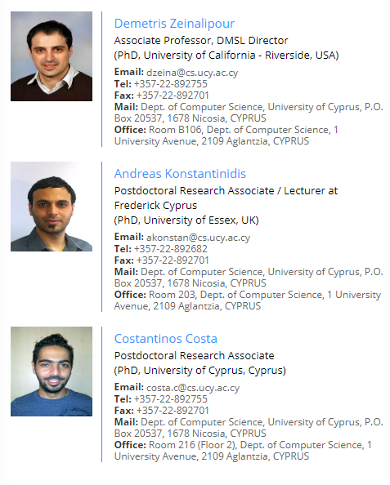


The (core) Teams
"Research in our laboratory focuses on Data Engineering Systems and Knowledge Discovery Solutions for emerging networks and systems (big data, smartphone, sensor, crowd, peer-to-peer, etc.)"

Slide 52
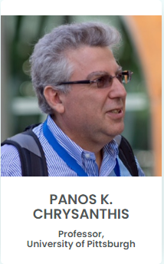
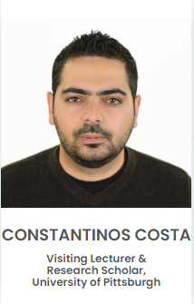




The (core) Teams
Research projects are targeted towards network-centric data management applications (e.g., mobile data management, sensor networks, web-databases, etc) and the approach taken is user-centric: emphasis is given on Quality of Service (QoS) and Quality of Data (QoD) returned to the users, and on controlling the trade-off between QoS and QoD, in a way that is prescribed by the users.
External Collaborators

Slide 53

Innovative Big Data Tools and Systems for Data Storage Efficiency
Constantinos Costa
costa.c@rinnoco.com
Co-founder & CEO,
Rinnoco Ltd
https://costadb.com
Thanks! Questions?
January 10, 2025
University of Pittsburgh

